Slide 1



Retail A Predictive Analysis of New Product Demand
Michael Wile
Modupe Ajala
Dana Lantion
Faculty Advisor: Dr. Amit Deokar
Notes:
Presentation
• Effective communication
• Ability to tell story throughout presentation that is relevant to the data and problem
• Relevant visual aids
• Balanced participation of all team members

Slide 2


Stage 1: Business Understanding
Business Understanding
Data
Notes:
Dana?

Slide 3
Business Understanding:
Description:
Parent Company:
Goal:
To be answered:
13-Week projected demand;
Which products will succeed or fail;
How soon can this be spotted;
Channel analysis (brick and mortar vs. Online)
Launch 20 new fashion products in March 2020
American manufacturer of sportswear clothing
HanesBrands

Slide 4
Stage 2: Data Understanding
Business Understanding
Data Understanding
Data
Notes:
The next step is make it smooth.

Slide 5
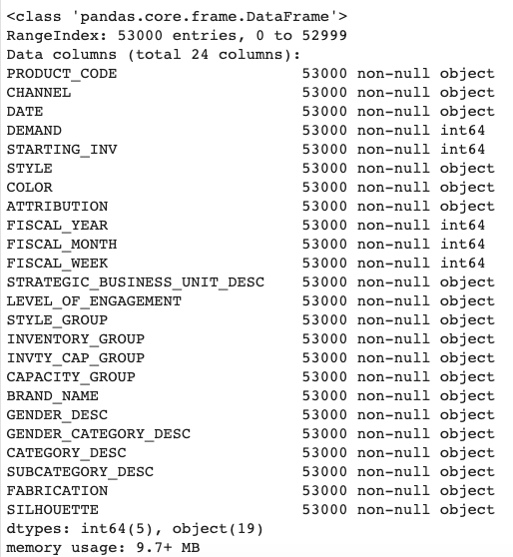
Data Understanding
Historical data summary
Historical data
53000 data points
1000 products
24 variables
22categorical
2 continuous
Used python and tableau for initial descriptive analysis
Notes:
We were given two datasets. An historical data and a new product data.
Our initial historical data contained 53,000 data points that ranged from January 2017 – October 2019.
It contained about 1000 products.
We analyzed our initial data using python and tableau for descriptive analysis/ summary.
Conducted several exploratory analysis to understanf the different variables like channel, fabrication and so on.
Don’t read the slides.
Analyzed intital data with 53,00 data point that ranged from 2017 - 19
Data ranged from 2017 – 2019 October.
53000, THAT INCLUDING ABOUT 1000 products
We analyzed initial data used python for descriptive analysis/ summary.
Conducted exploratory analysis to understanfd the different variables like channel, fabrication and so on.
Enthutiasm excitement

Slide 6
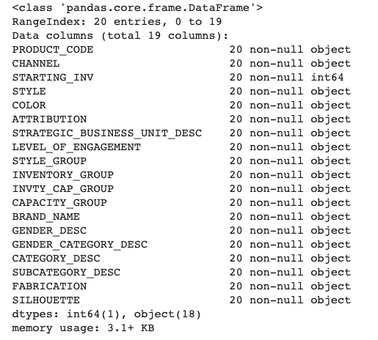
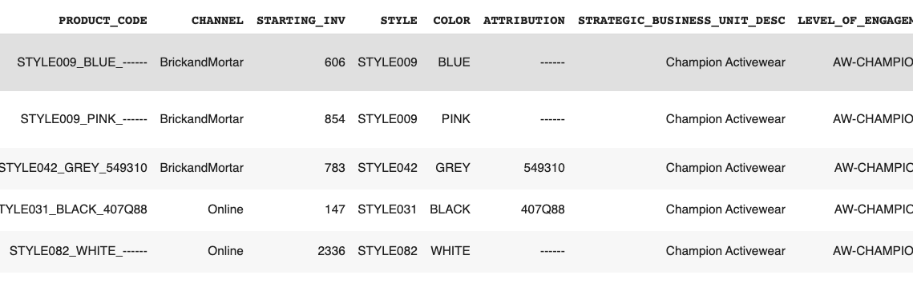
Data Understanding (cont.)
New product data summary
New product data
20 observations
19 variables
18 categorical
1 continuous
Notes:
The new product data was brief, it contained the 20 new product champions plans on launching in march 2020.
We also analyzed the new product data using python and tableau.

Slide 7
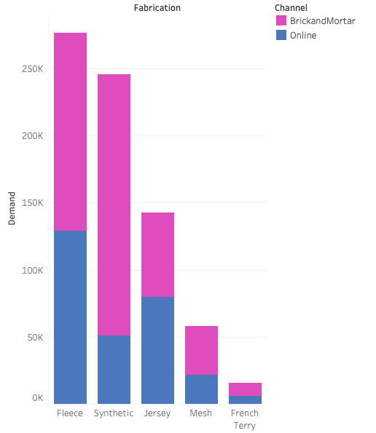
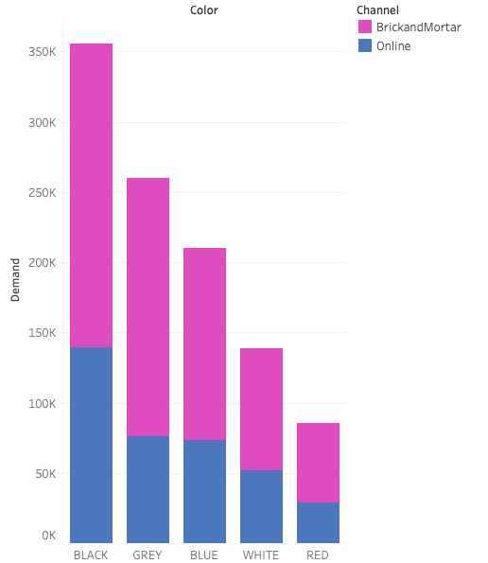
Descriptive Plots
Notes:
During our exploratory analysis we created variety of plots on tableau to give us a good understaning of the data. Here are some illustrations.
Fleece and syntetic fabrics had the highest demand across channels as well as color black and grey which makes sense as they are neutral colors.
Make slide about how a new product is similar to existing product
Descriptive plots.
During exploratory analysis we created variety of plots on tableau to give us a good understaning of the data. Here are some to give an example.
To illutstrate flece and synthetic and balck and grey had highest demand across channels

Slide 8
Stage 3: Data Preparation
Business Understanding
Data Understanding
Data Preparation
Data

Slide 9
Data Preparation
Excluded 2017
Lack of data from November to December 2019
Selected months from January 2018 to June 2018 then January 2019 to June 2019
Treated each 6-month period as a whole season
Both 6-month periods were then concatenated into one single dataset
Selected historical data that best represented new products
Selected data based on Style Group, Color, and Fabrication
Created datasets that had the most observations possible while being specific enough to address each new product
If there was more than one observation for a time period, we averaged the demand for those observations
Extreme variance in product demand from years 2018 and 2019
Notes:
We noticed there was high variance in 2017’s product demand as compared to 2018 and 2019, so we selected data from jan –June 2018 & 2019. we selected two time periods of 6 months because we wanted to represent two seasons and look at the seasonal patterns across the two peroids.
The next step was to map our data sets. Demand for the new product data is currently unknown, so in order to predict demand we analyzed and found products that are most similar in the the historical data.
We built a product hierarchy based on data dictionary to create different dataset for each data point.
We mapped new product data with the historical data to get the datapoints that best represented the the new product.
Demand for the new product is not know at all, to be a ble to predict demand of new products we found similar products to the historical data.
Notes:
Selected data from Jan – June because 2019 lacked November – December 2019 data was problematic. Because we wanted to represent two seasons .
We selected two time period sof 6months from jan to June 2019 based on the variation we could capture gather and minimizing the least missing value our also the 6 month period will allow us look at the se4asonal patterns across the two periods.
We built a data hierarchy based on data dictionary to create different dataset for each data point

Slide 10
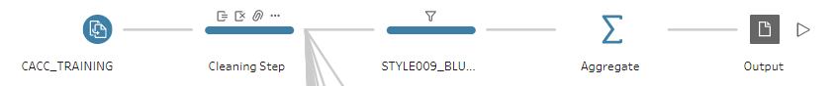
Preprocessing Example with STYLE009_BLUE
Removed White Spaces
Merged UNDEFINED observations with Other
Excluded 2017 Data
Excluded Months July to December
Selected Style Group " Aw-Ch-Performance-W"
Selected Fabrication "Jersey"
Selected Colors "Black" and "Blue"
Averaged Data by Channel and Week Period
Notes:
This is a visual example of our preprocessing step and Asyou can see, we used tableau prep to builld a pilpeline .
Some of the cleaning steps we did includes removing whitespaces, Making sure the product hierarchy is as intended, selecting our timeperiods and so on.
We Aggregated the data based on channel and weeks.
We did a similar process for all the products
Talk about hieachy.

Slide 11
Stage 4: Modeling
Business Understanding
Data Understanding
Data Preparation
Data
Modeling
Notes:
Now lets talk about our models

Slide 12
Modeling
Time Periods Used:
2018
2019
Data Segmentation:
Train (39 Weeks)
Test Set (13 Weeks)
Transformed values by differencing them by 1 period
Rescaled values so both min and max values are within –1 and 1 boundary
Imputed missing values by comparing past season with linear interpolation
Notes:
We started out by partitioning our data into train and test set. we used the first 39weeks for training and the remaining 13weeks for testing.
We addressed the missing value using linear interpolation techniques… what is that?
In order to improve the stationarity of the data we did differencing.
For the purpose of analysis We standardized the demand between -1 and 1 to avoid any scaling issues.
We used lstm arima

Slide 13
Modelling: Statistical and Machine Learning Models
ARIMA
Seasonal Naive
LSTM
All models were unmodified to simulate quick turnover time series simulations needed for time sensitive supply chain logistics.​
Notes:
Say seasonal first, then Arima then lstm.
We explored three models… Arrima, seasonal naïve and Lstm. Lets talk about our models
I am sure some of you are familiar with Arima. And if not, it stands for Autoregressive moving average. It is the most common in time series.
Seasonal naïve is our most basic model. It takes the previous seasons demand and forecast for next season corresponding to the pervisous season
Lastly we used lstm,
Since a lot of people aren’t familiar with this models. Ill explain further.

Slide 14
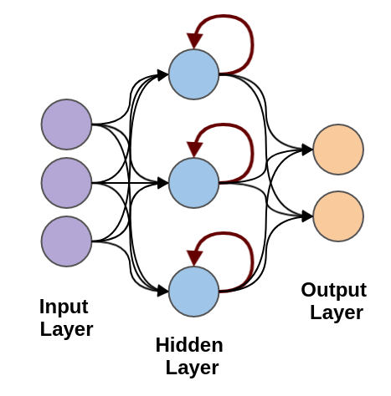
Recurrent Neural Network – Long Short Term Memory (LSTM)
LSTM is a deep learning model
LSTM is a type of Recurrent Neural Network (RNN) architecture
Similar to a Neural Network but has the ability to 'remember' the past for better predictions of the future
LSTM can 'remember' farther back than a traditional RNN
Source: https://austingwalters.com/classify-sentences-via-a-recurrent-neural-network-lstm/
Notes:
Lstm stands for long short term mermory. It is a deep learning model. It’s a type of Recurrent Neural Network that has the ability to remembertr the past and can predict the future better. It is expected to do better than Arrima.
The architecture tries to loop the past to remember sequential datya. reme
Expected to odo better than Arima

Slide 15
Stage 5: Evaluation
Business Understanding
Data Understanding
Data Preparation
Data
Modeling
Evaluation

Slide 16
Evaluation
Seasonal Naïve Model
ARIMA Model
LSTM Model
Least performing model
Baseline to improve our other models
Average performing model
Improvement of RMSE of 1-2 from Seasonal Naïve Model on average
Best Model
Averaged an RMSE of 4 in test/train set
Improved prediction by more than double (than ARIMA) on average considering RMSE and MAPE
Notes:
Seasonal Naïve Model:
Least Performing Model
Was the baseline to improve our other models
ARIMA Model:
Average Performing Model
Average RMSE of 1-2 improved from Seasonal Naïve Model
LSTM Model:
Best Model
Average RSME of 3.1-4 in test/train set
Improved prediction by more than double (than ARIMA)

Slide 17
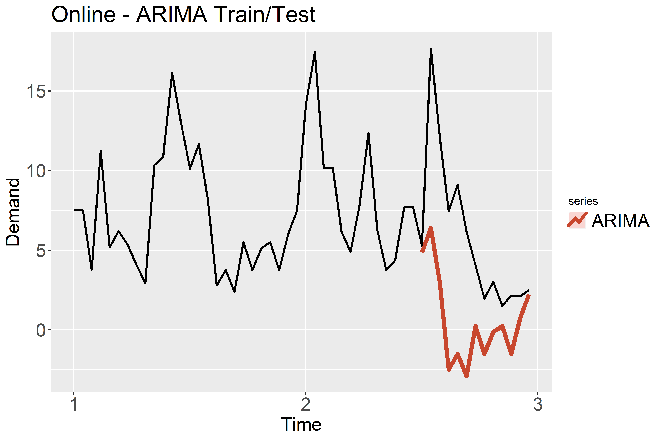
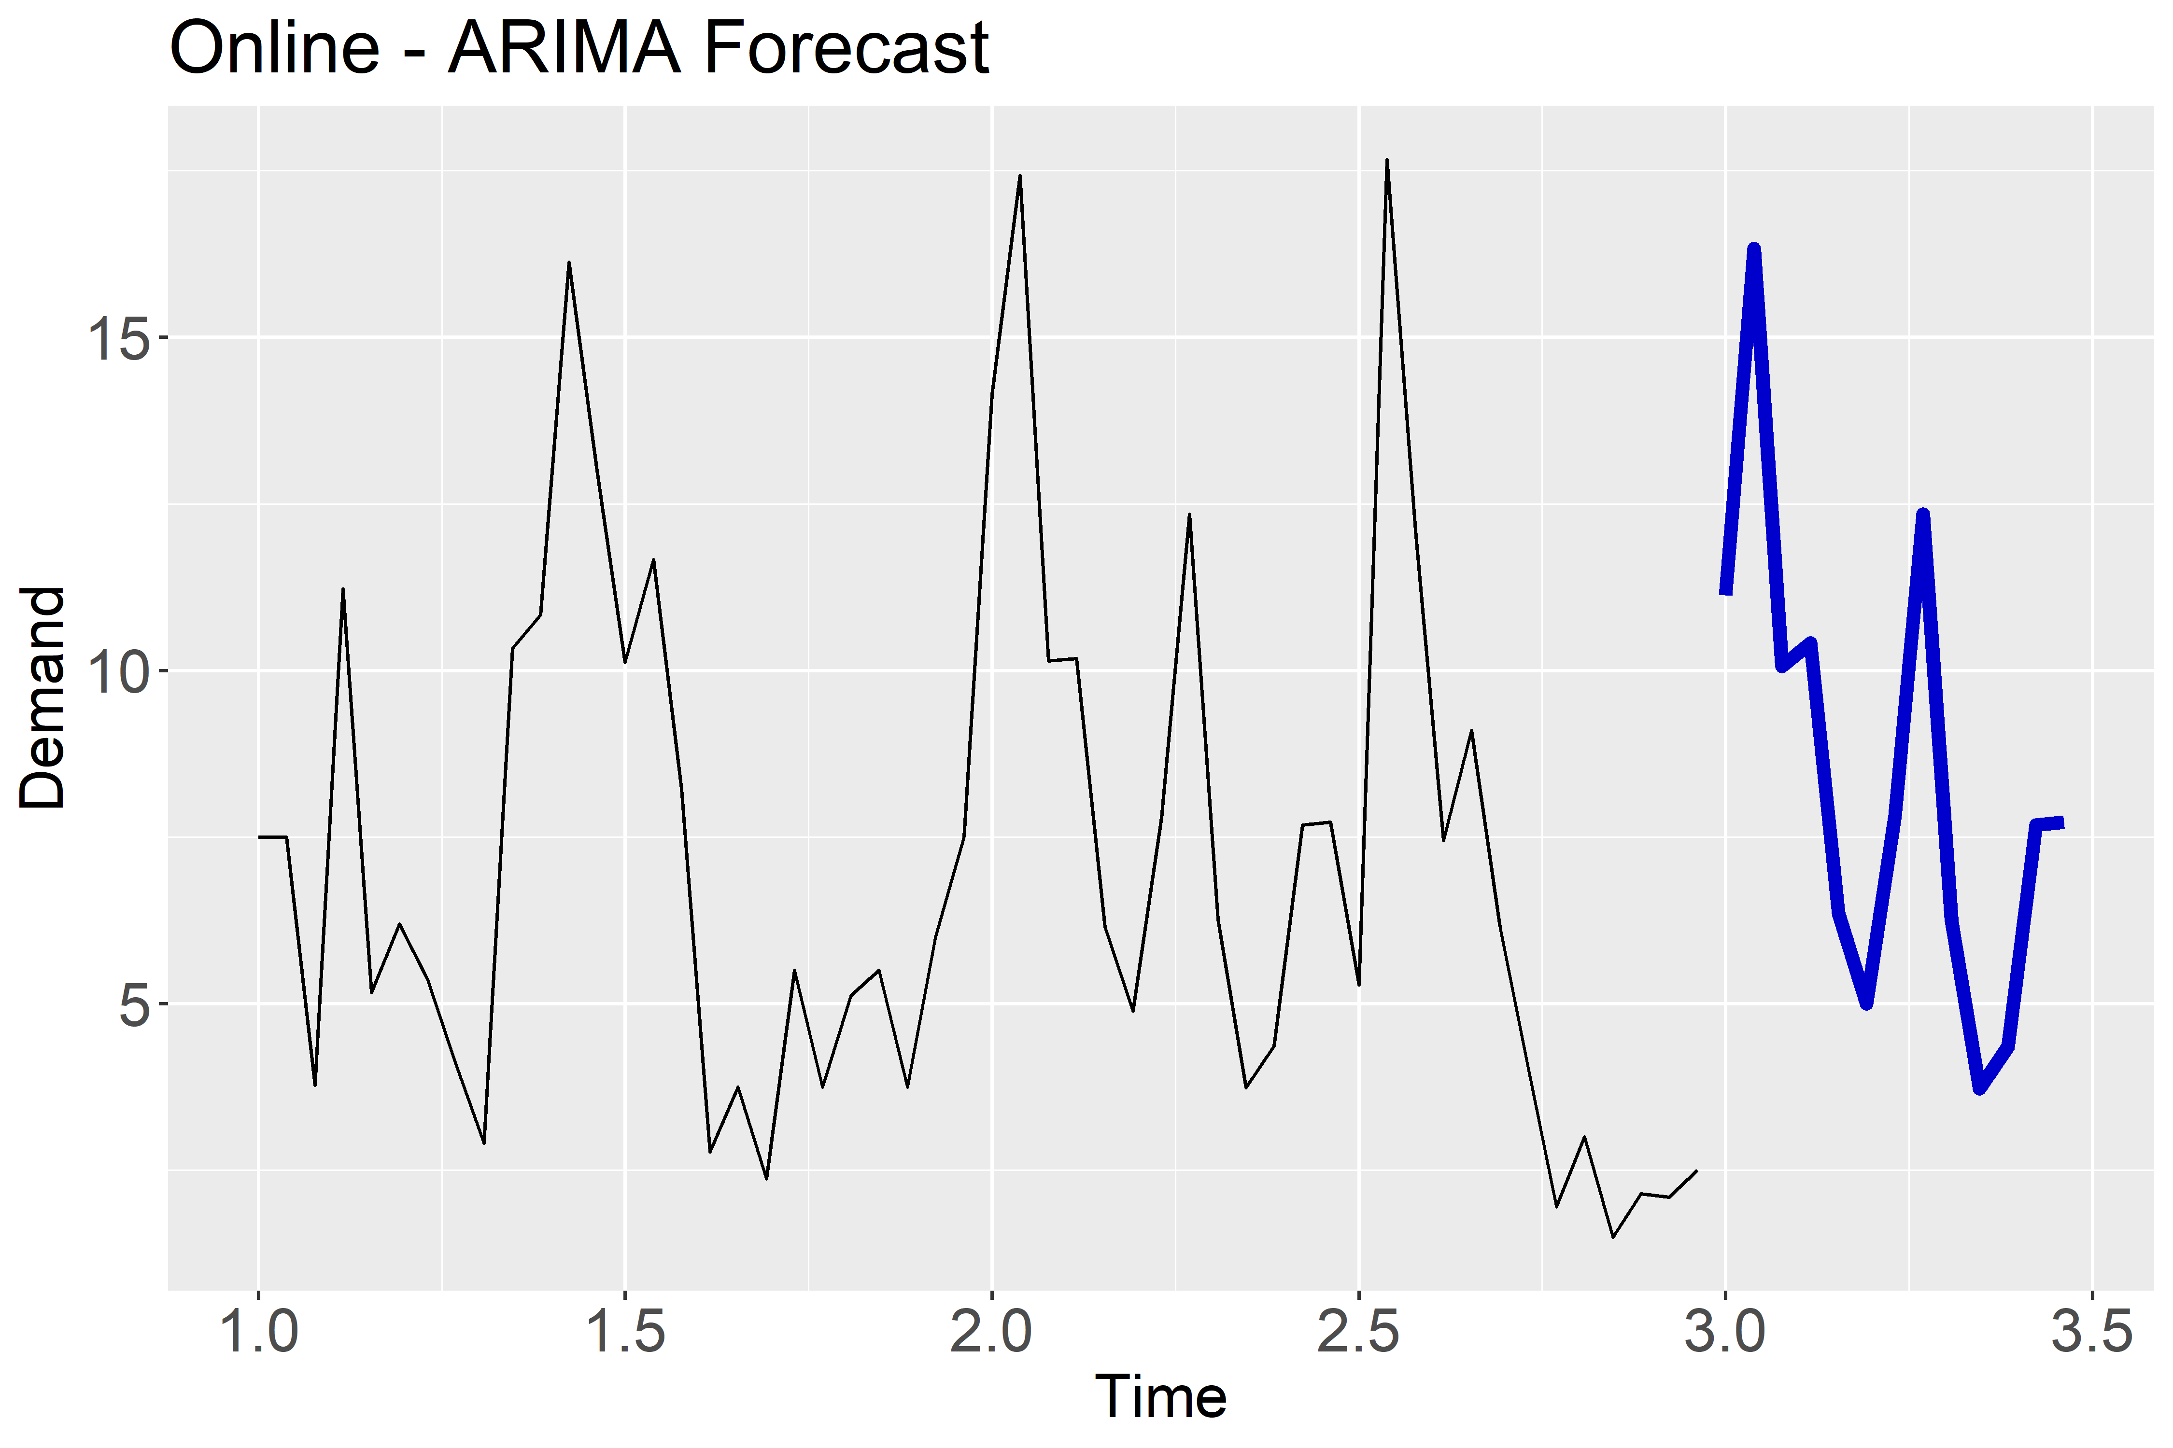
Online – STYLE105_PURPLE (ARIMA)
Legend
Time 1: January 2018
Time 2: January 2019
Time 3: January 2020
Root Mean Squared Error | Mean Absolute Error | Mean Absolute Percentage Error
6.55 | 5.19 | 96.49%

Slide 18
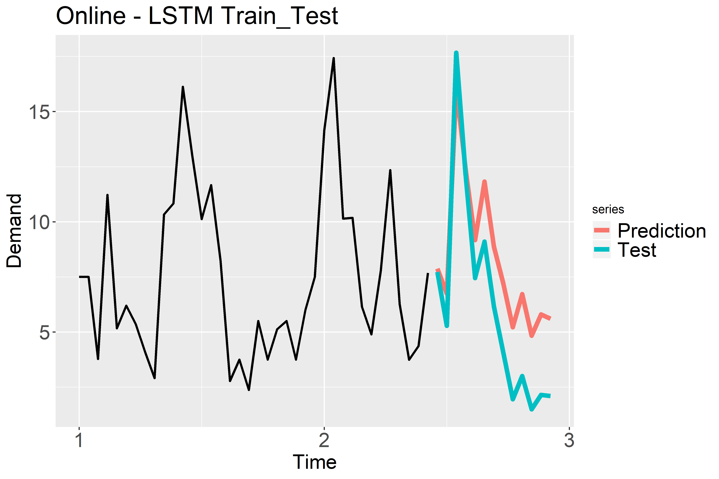
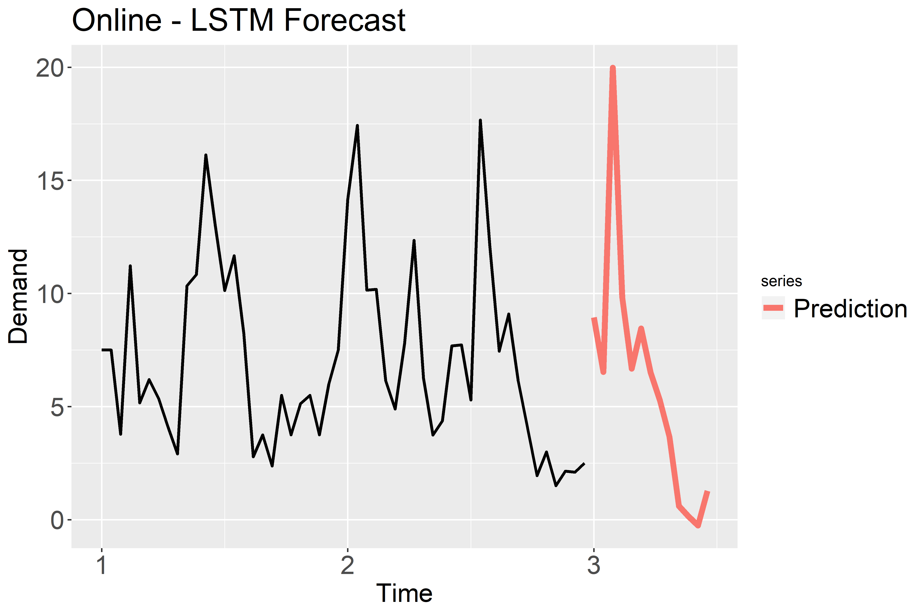
Online – STYLE105_PURPLE (LSTM)
Legend
Time 1: January 2018
Time 2: January 2019
Time 3: January 2020
Root Mean Squared Error | Mean Absolute Error | Mean Absolute Percentage Error
4.58 | 3.89 | 37.2%
Notes:
Clearly the error has reduced drastically.

Slide 19
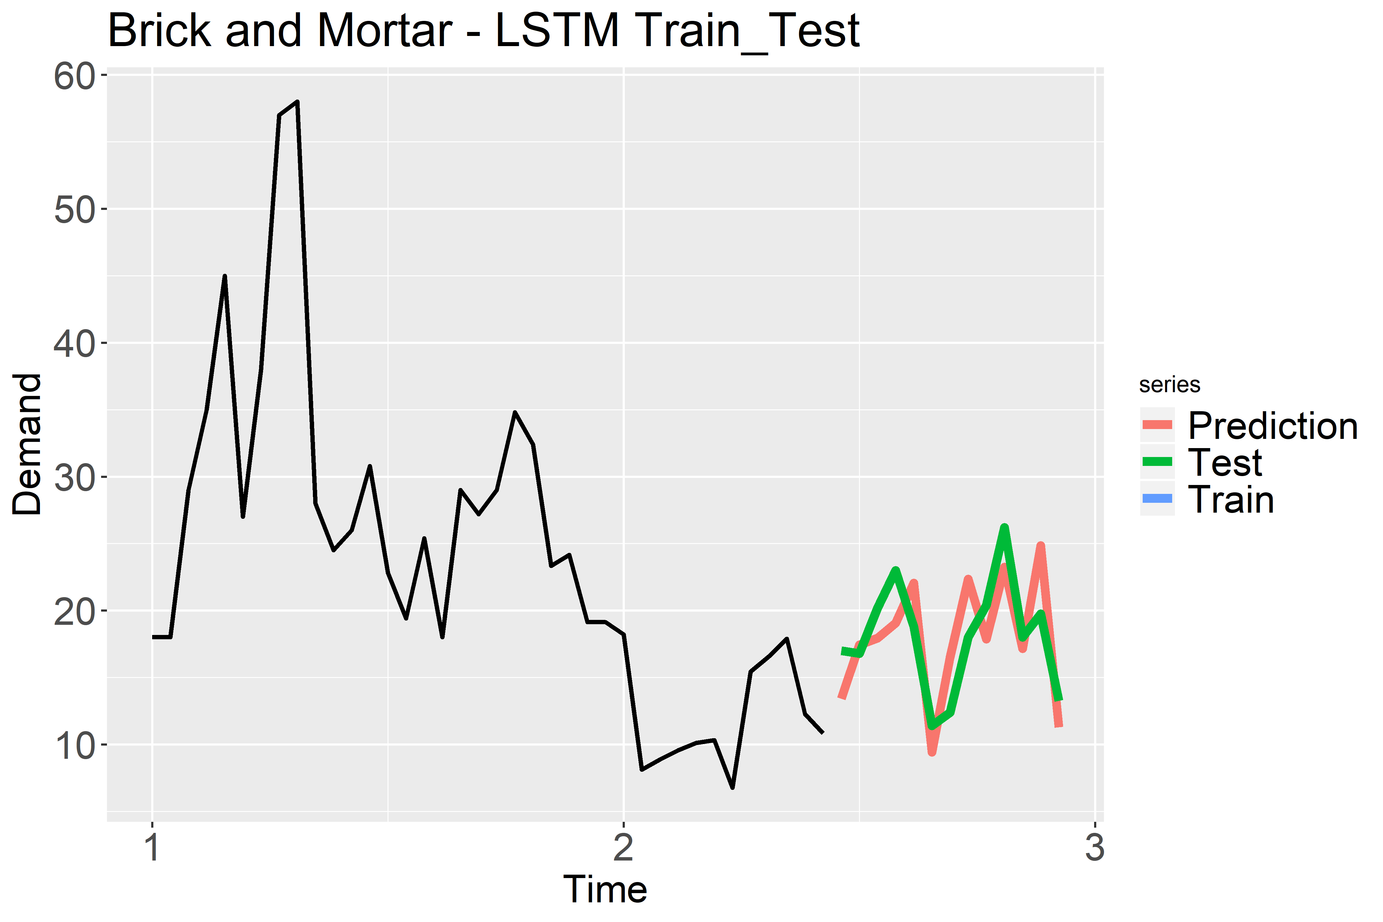
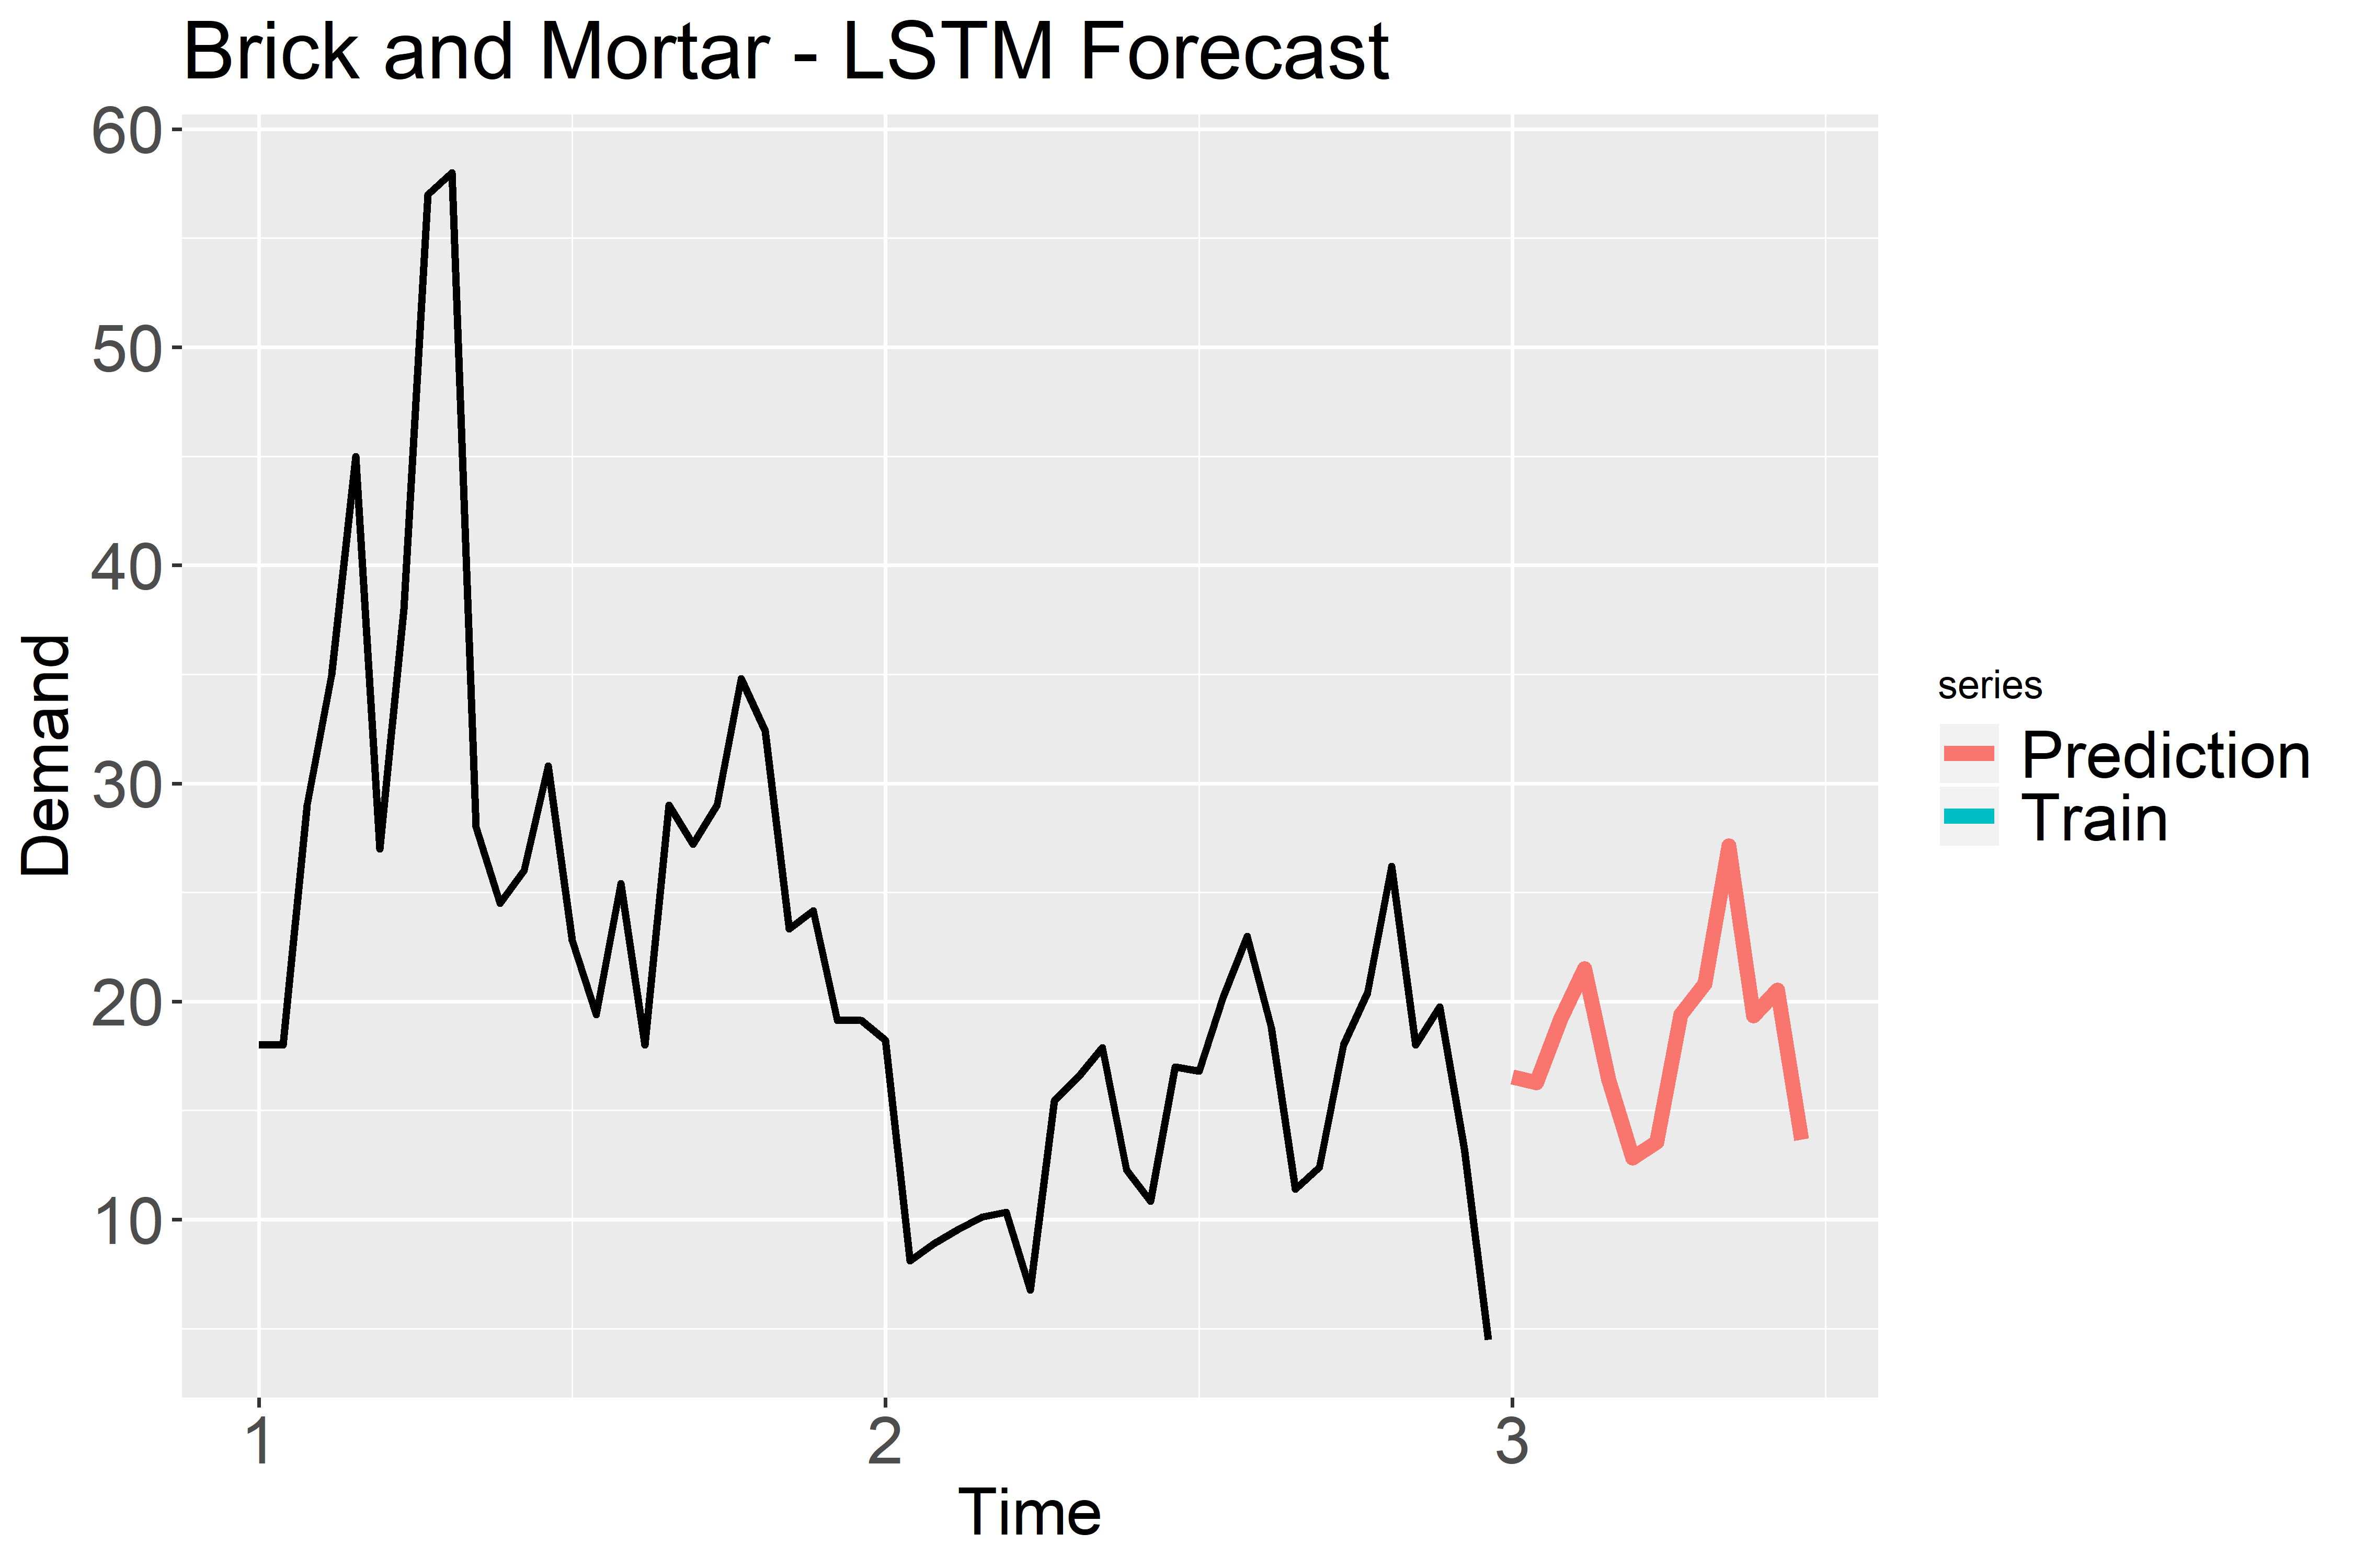
Brick and Mortar – STYLE009_BLUE (LSTM)
Legend
Time 1: January 2018
Time 2: January 2019
Time 3: January 2020
Root Mean Squared Error | Mean Absolute Error | Mean Absolute Percentage Error
3.16 | 2.88 | 16.4%

Slide 20
Success or Failure?
Notes:
How early can you tell that a product is going to succeed or fail?
Short/medium/long term comparison? Qualitative and quanitive?

Slide 21
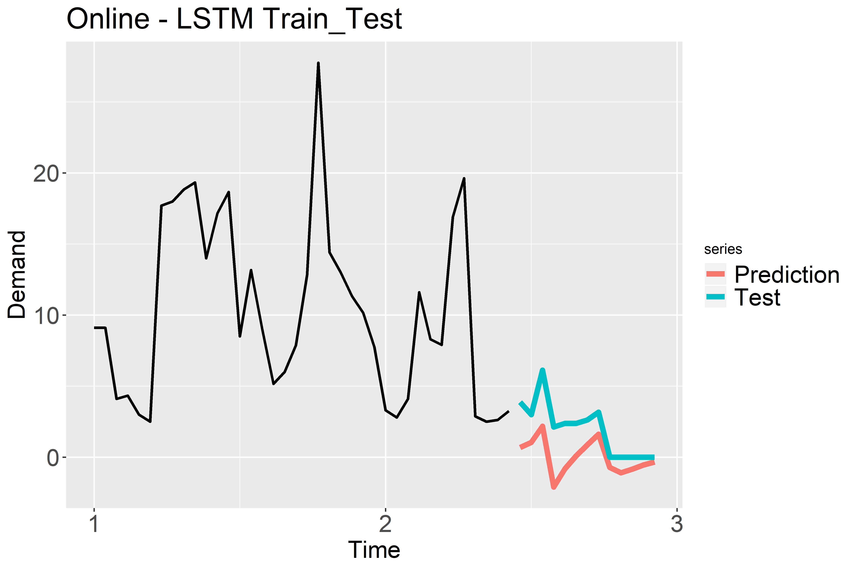
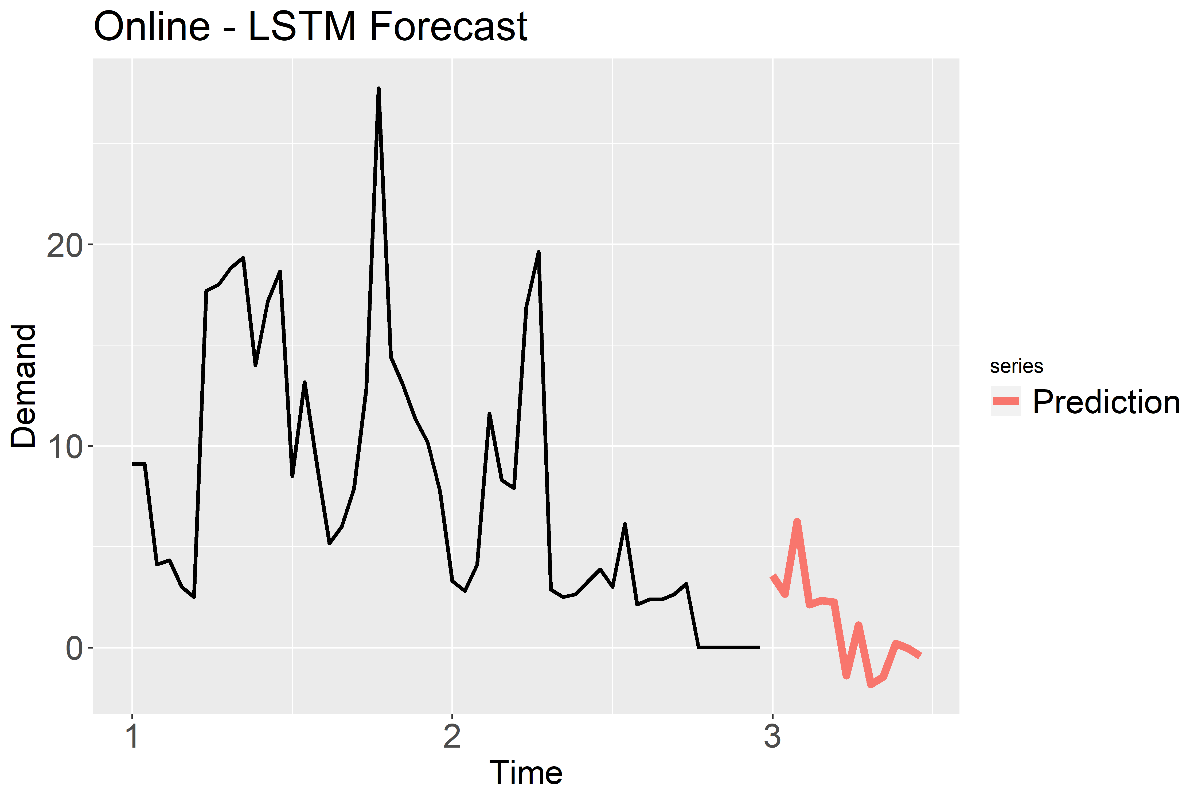
Online - STYLE116_BLACK_549314
Legend
Time 1: January 2018
Time 2: January 2019
Time 3: January 2020
Root Mean Squared Error | Mean Absolute Error | Mean Absolute Percentage Error
2.70 | 1.98 | 113.13%
Notes:
To answer qst on success and failure we relied on the accuracy of the model.
The closer the test data performed to the d
The closer the test data s prediction is to our models prediction the better the recommendation.

Slide 22
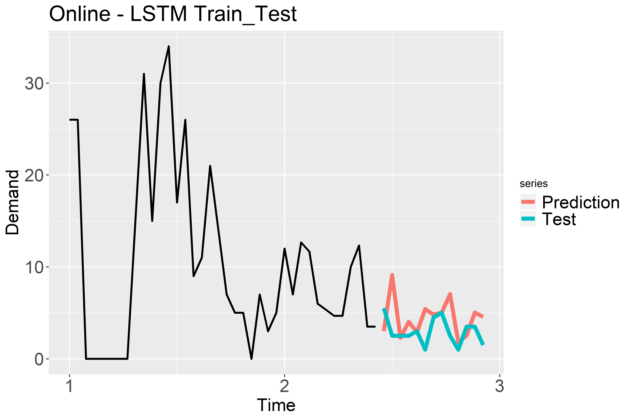
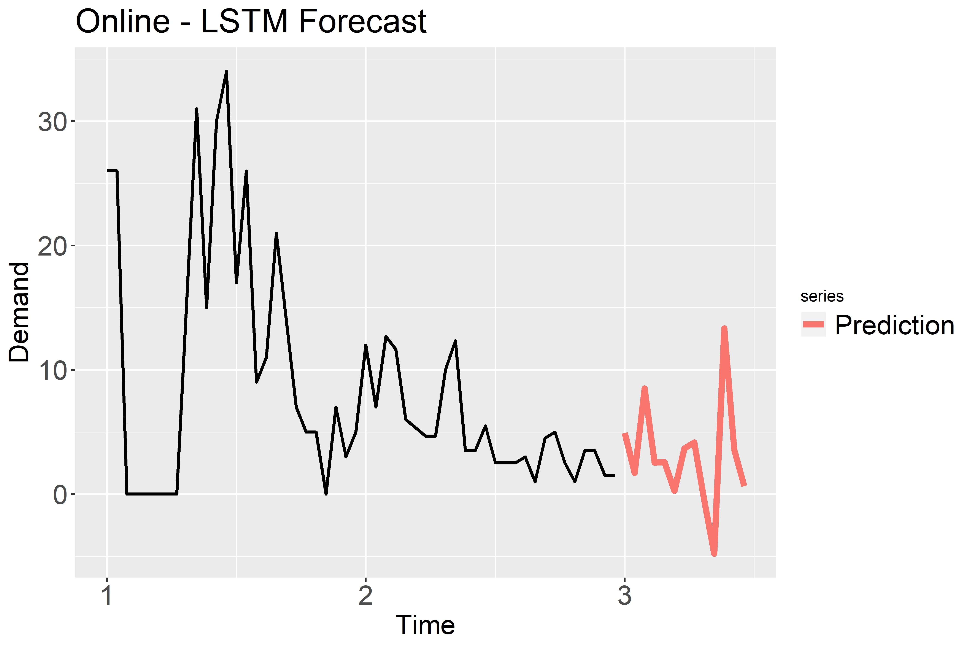
Online - STYLE189_BLACK_------
Legend
Time 1: January 2018
Time 2: January 2019
Time 3: January 2020
Root Mean Squared Error | Mean Absolute Error | Mean Absolute Percentage Error
2.71 | 2.09 | 46.47%
Notes:
Produce

Slide 23
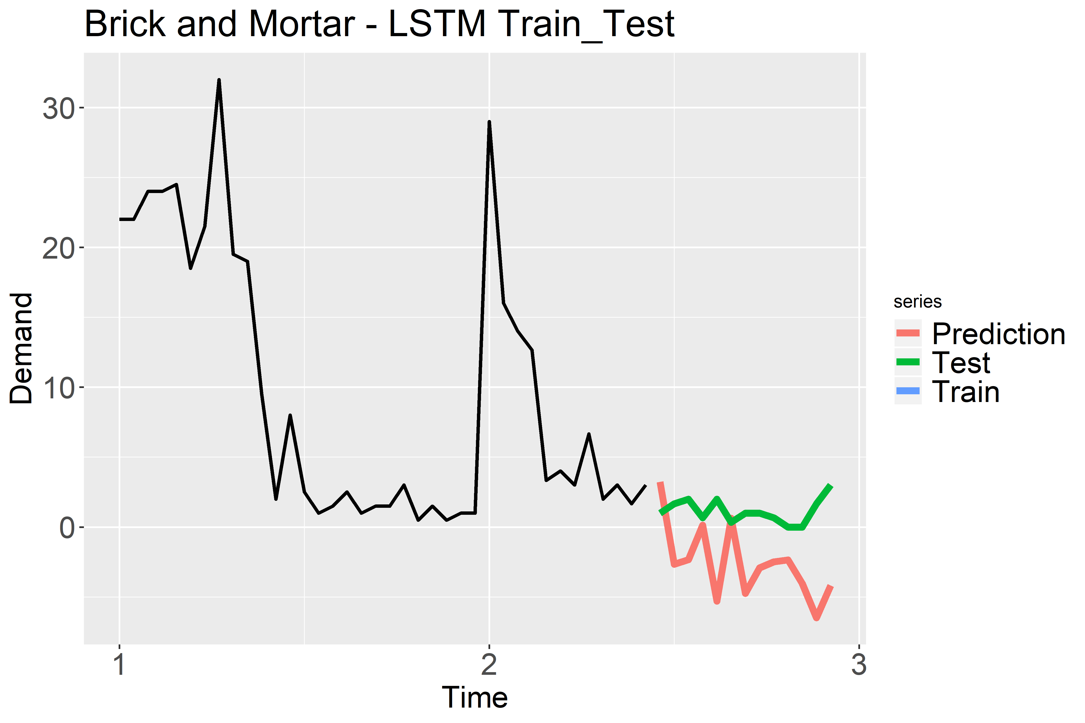
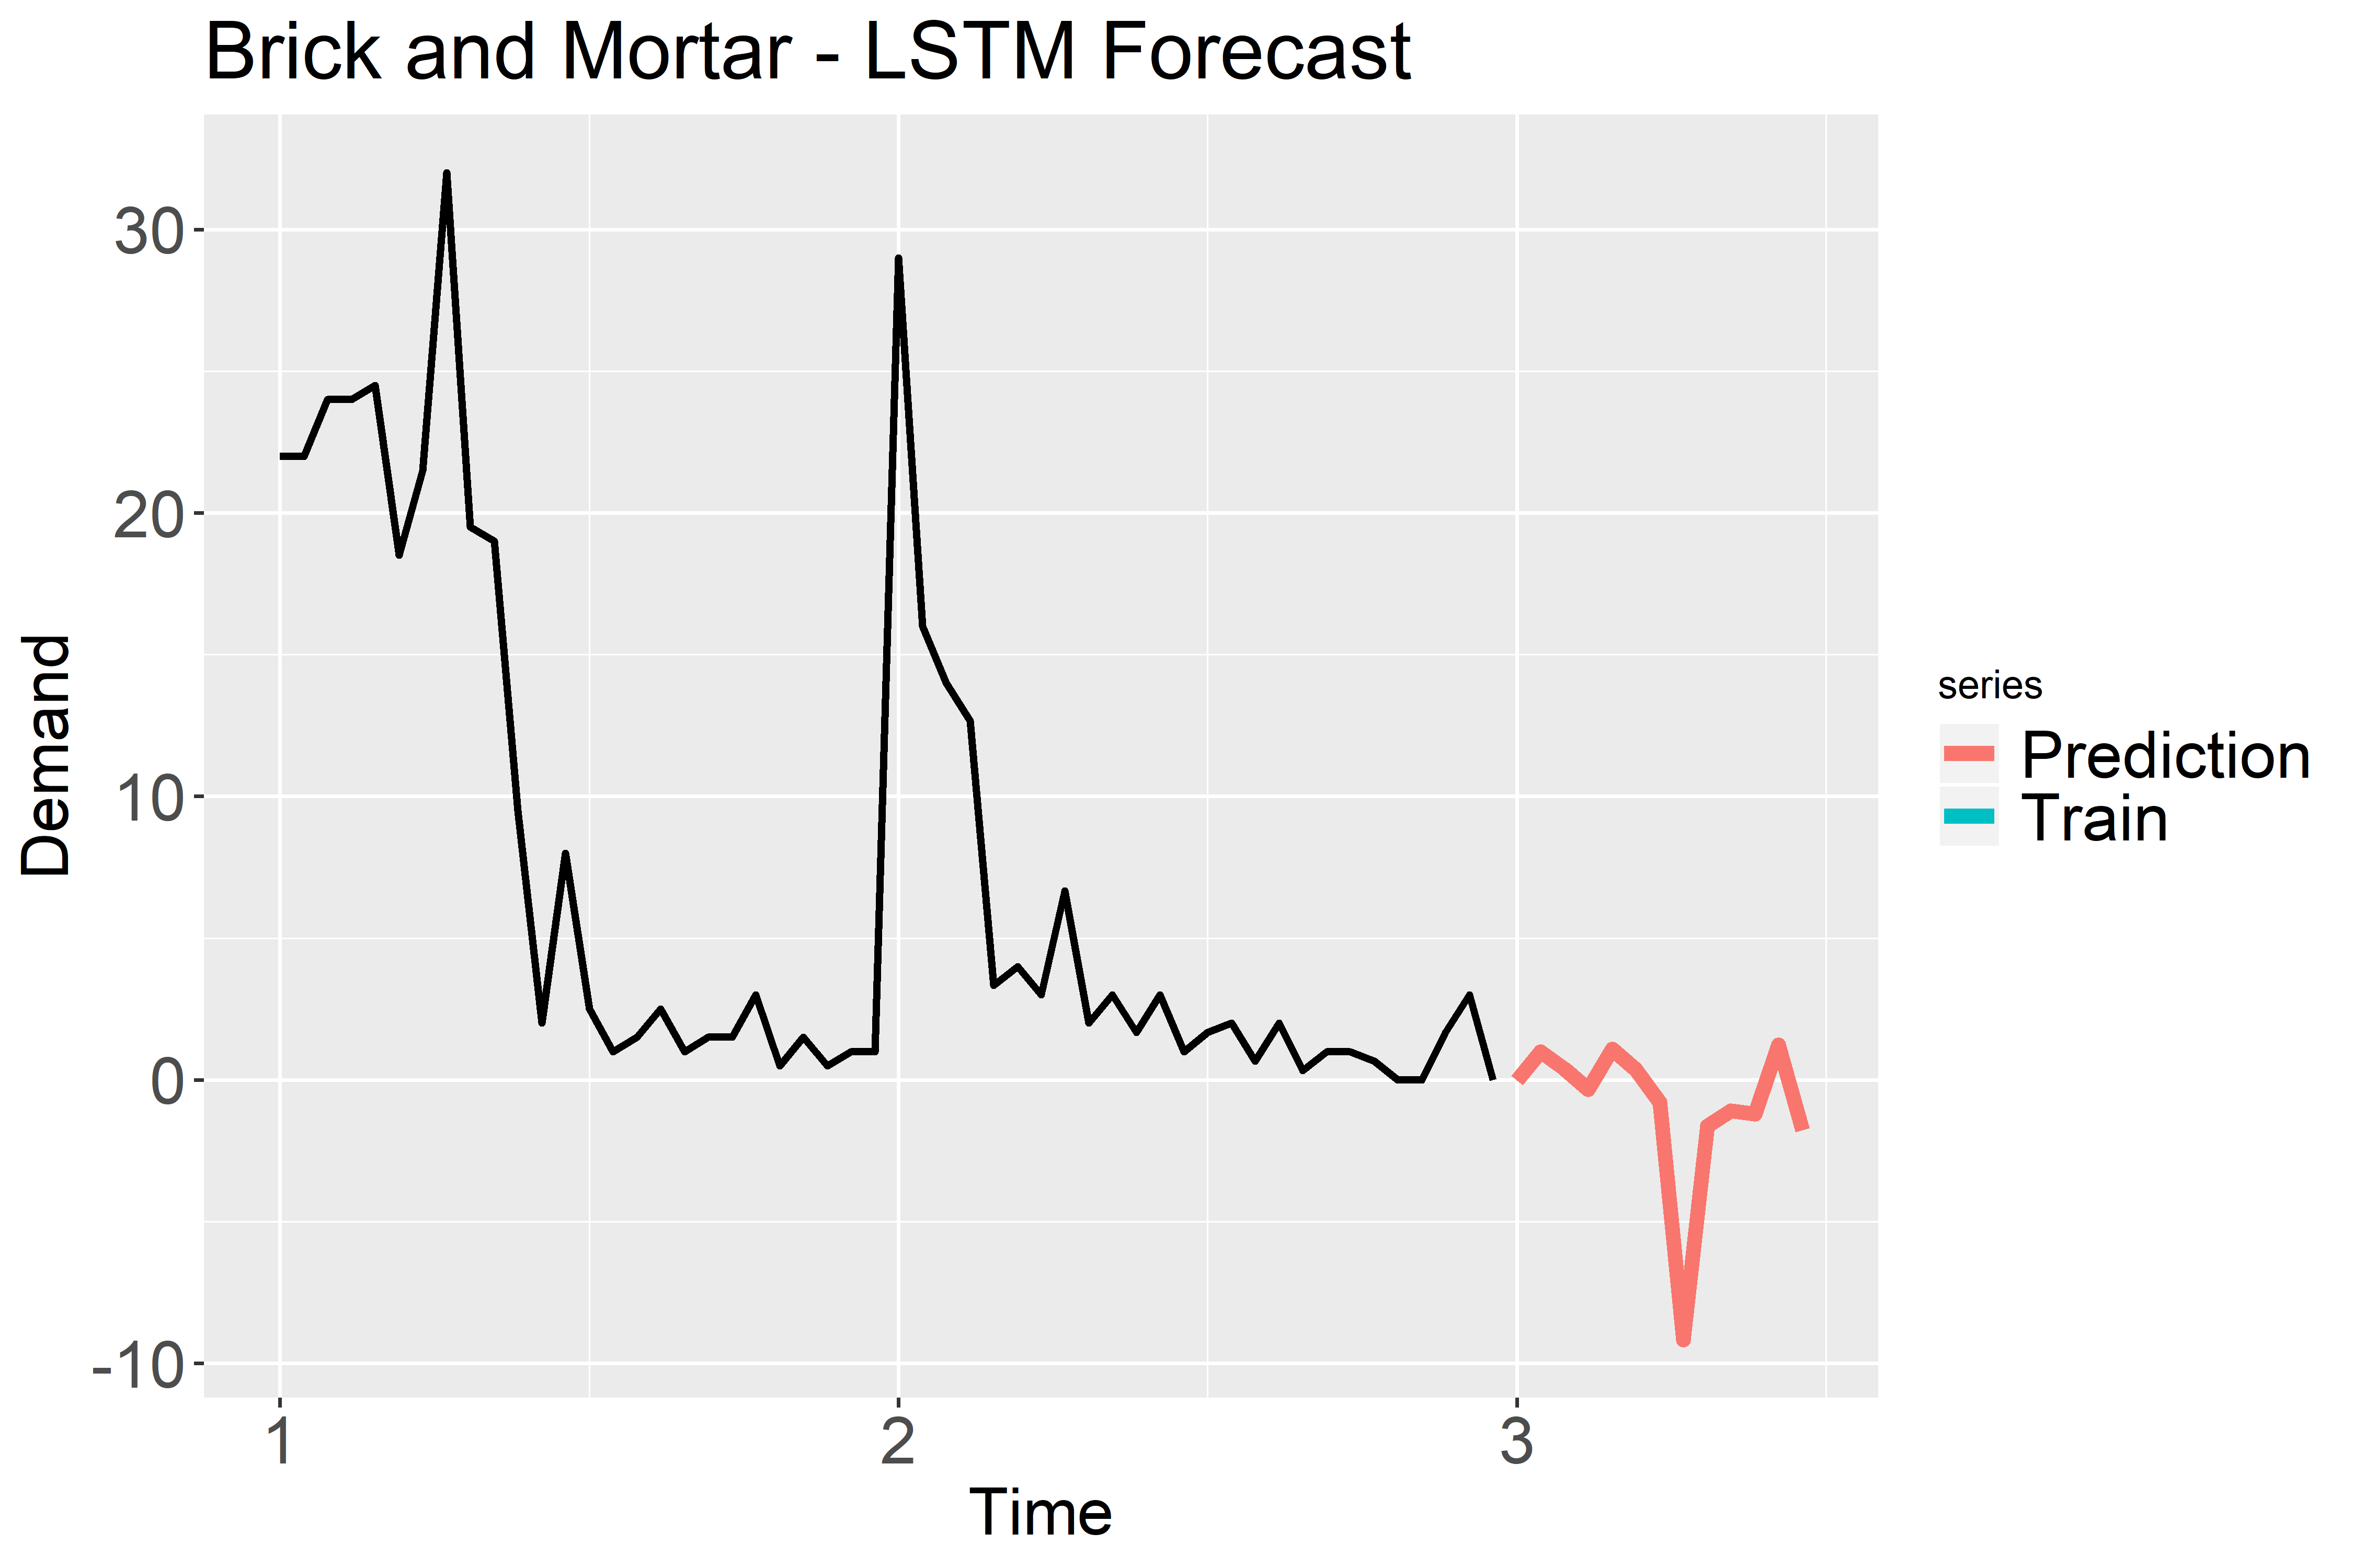
Brick and Mortar – STYLE276_BLACK_549333
Legend
Time 1: January 2018
Time 2: January 2019
Time 3: January 2020
Root Mean Squared Error | Mean Absolute Error | Mean Absolute Percentage Error
4.76 | 4.12 | 145.81%
Notes:
Not Produce
This indicates there is no confidene in the model to suggest producing or not procing the model

Slide 24
Forecasted Significant Decrease in Demand – What to do?
Stop Production Recommendations
Both train/test results are not as accurate as desired and forecast is producing undesired results
Product has accurate train/test results but a negative forecast
Produce but Watch
For a product that has lackluster train/test results but positive forecast, we would recommend to produce that product but to continue to refresh model regularly to see if any changes occur.
Note: Chose to run unmodified models to simulate quick turnover time series simulations needed for time sensitive supply chain logistics
Notes:
Explain based off of previous slide analysis (compare short,medium,long)

Slide 25
Stage 6: Deployment
Business Understanding
Data Understanding
Data Preparation
Data
Deployment
Modeling
Evaluation

Slide 26
Recommendation Parameters
Not Recommended: Forecasting Model repeatedly predicted a demand below 0 considering Train/Test accuracy
Recommended: Continuous/increased with past performance after considering Train/Test accuracy

Slide 27
Performance by Channel: BRICK AND MORTAR
Produce
STYLE009_BLUE_------
STYLE009_PINK_------
STYLE329_BLACK_40GEAR
STYLE366_BLACK_------
STYLE179_BLUE_------
Don't Produce
STYLE042_GREY_549310
STYLE203_GREY_549314
STYLE264_RED_------
STYLE276_BLACK_549333
STYLE359_BLUE_------

Slide 28
Performance by Channel: ONLINE
Produce
STYLE031_BLACK_407Q88
STYLE082_WHITE_------
STYLE087_GREY_------
STYLE104_BLUE_Y06085
STYLE105_PURPLE_Y06145
STYLE189_BLACK_------
Don’t Produce
STYLE116_BLACK_549314
STYLE207_BLUE_407D55
STYLE357_GREY_------
STYLE111_RED_Y06145

Slide 29
Concluding Remarks
Notes:
Dana

Slide 30
Concluding Remarks
Historical Data vs New Products​
3 Models: ARIMA, Seasonal Naïve, LSTM ​
Best Model: LSTM

Slide 31
Appendix

Slide 32
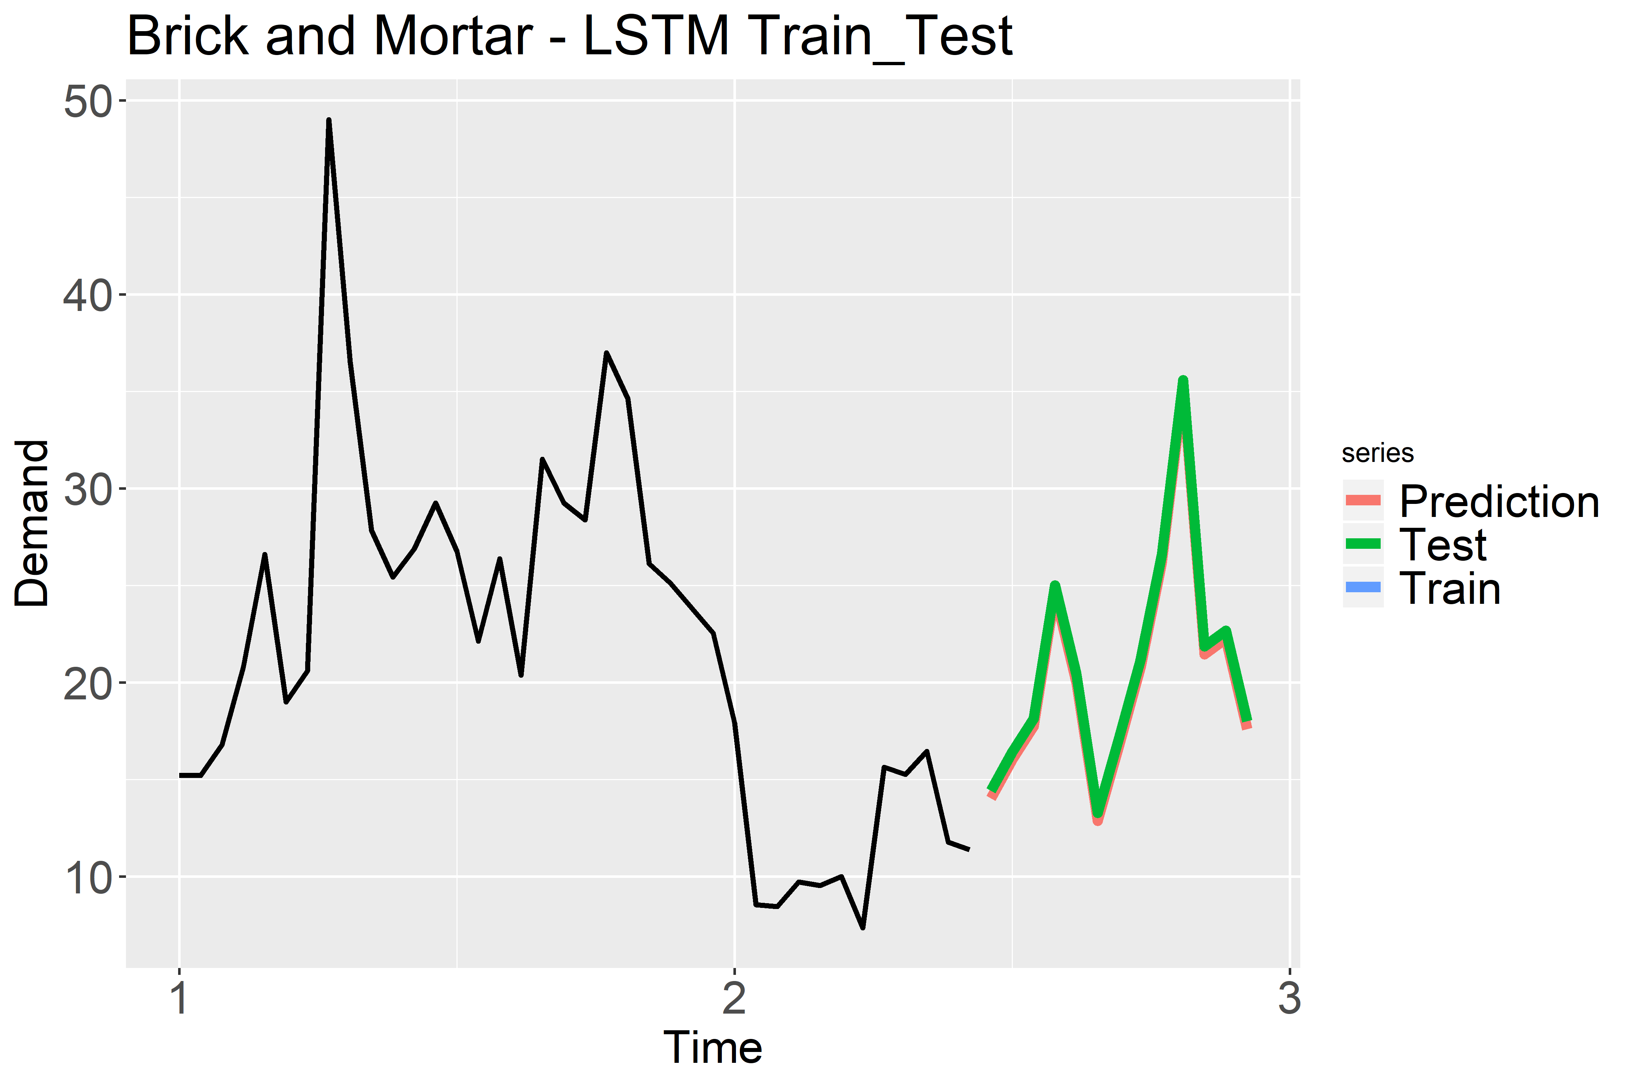
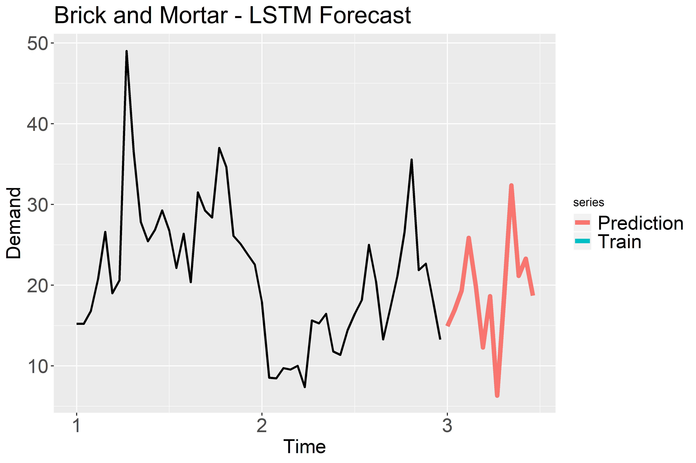
Brick and Mortar – STYLE009_PINK
Legend
Time 1: January 2018
Time 2: January 2019
Time 3: January 2020

Slide 33
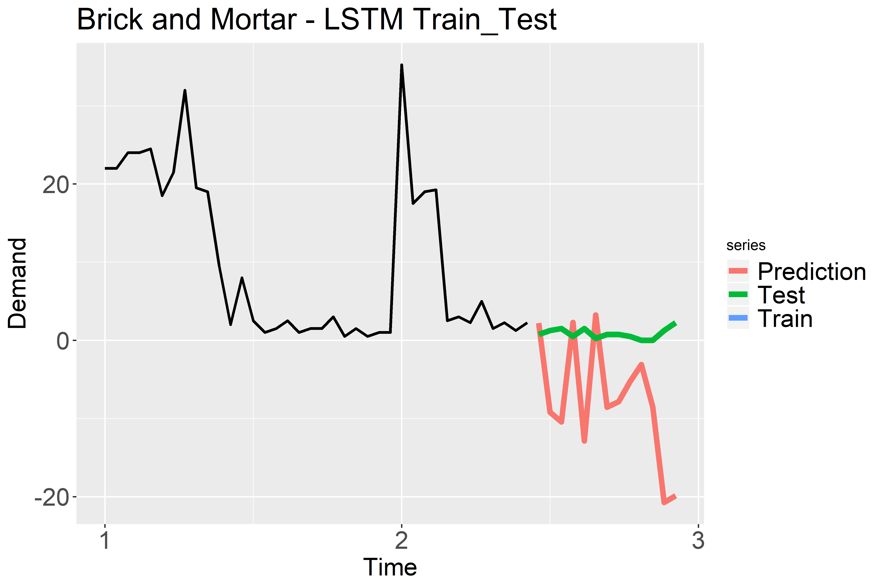
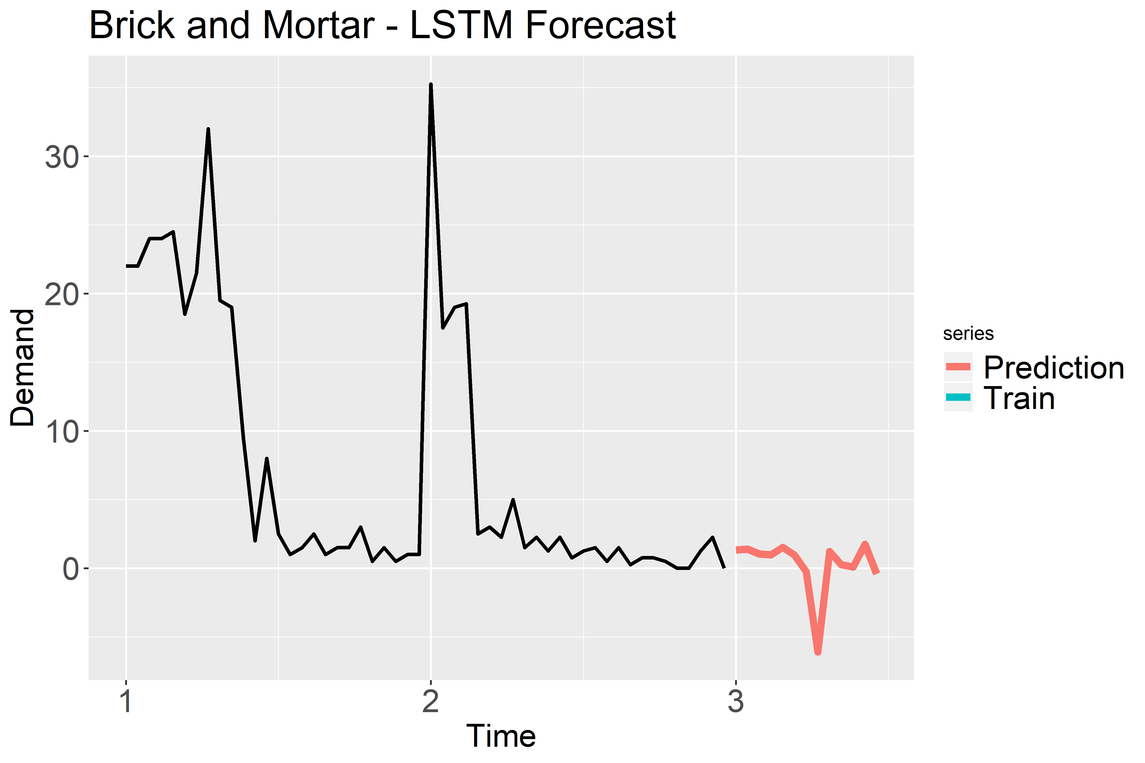
Brick and Mortar – STYLE042_GREY_549310
Legend
Time 1: January 2018
Time 2: January 2019
Time 3: January 2020

Slide 34
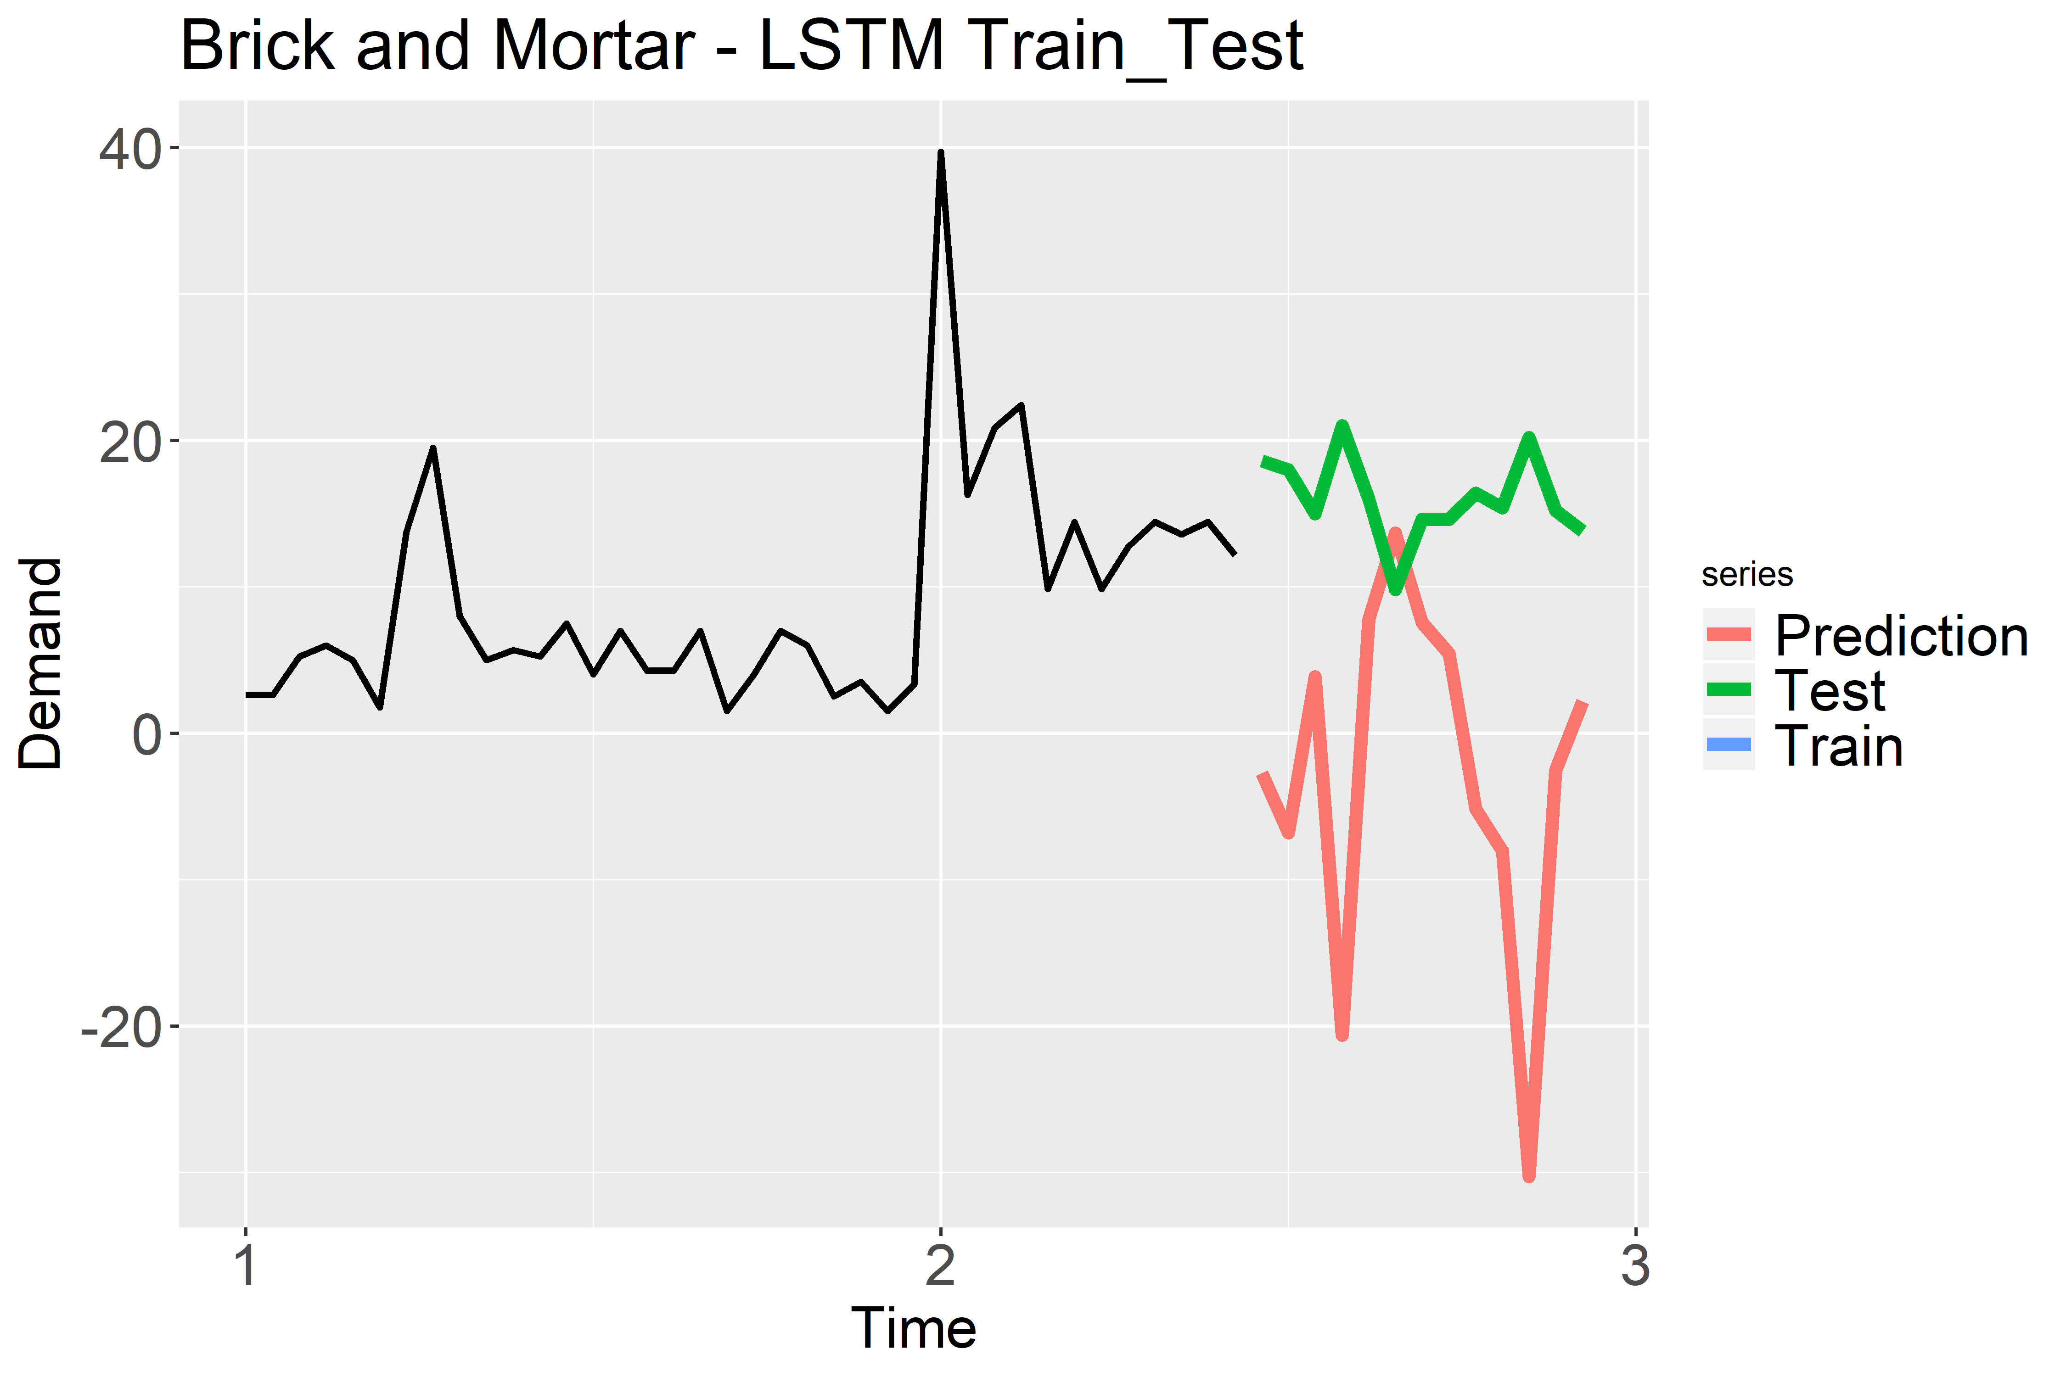
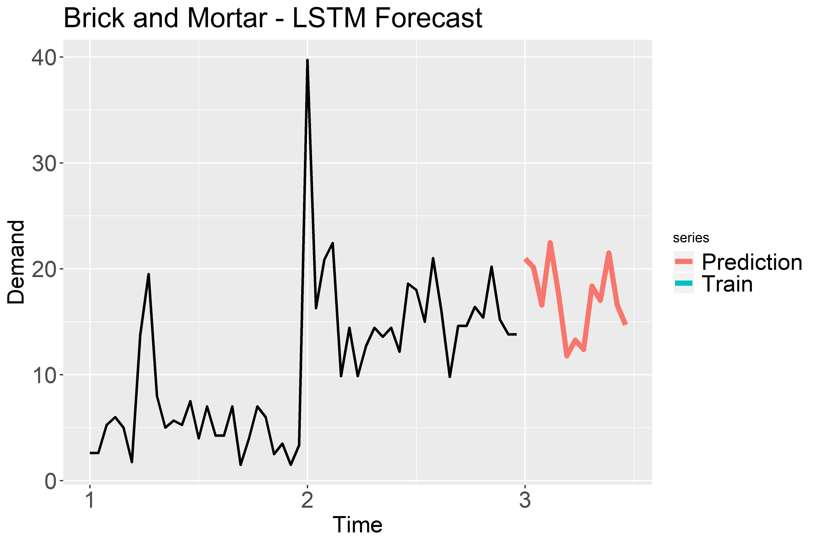
Brick and Mortar – STYLE179_BLUE_------
Legend
Time 1: January 2018
Time 2: January 2019
Time 3: January 2020

Slide 35
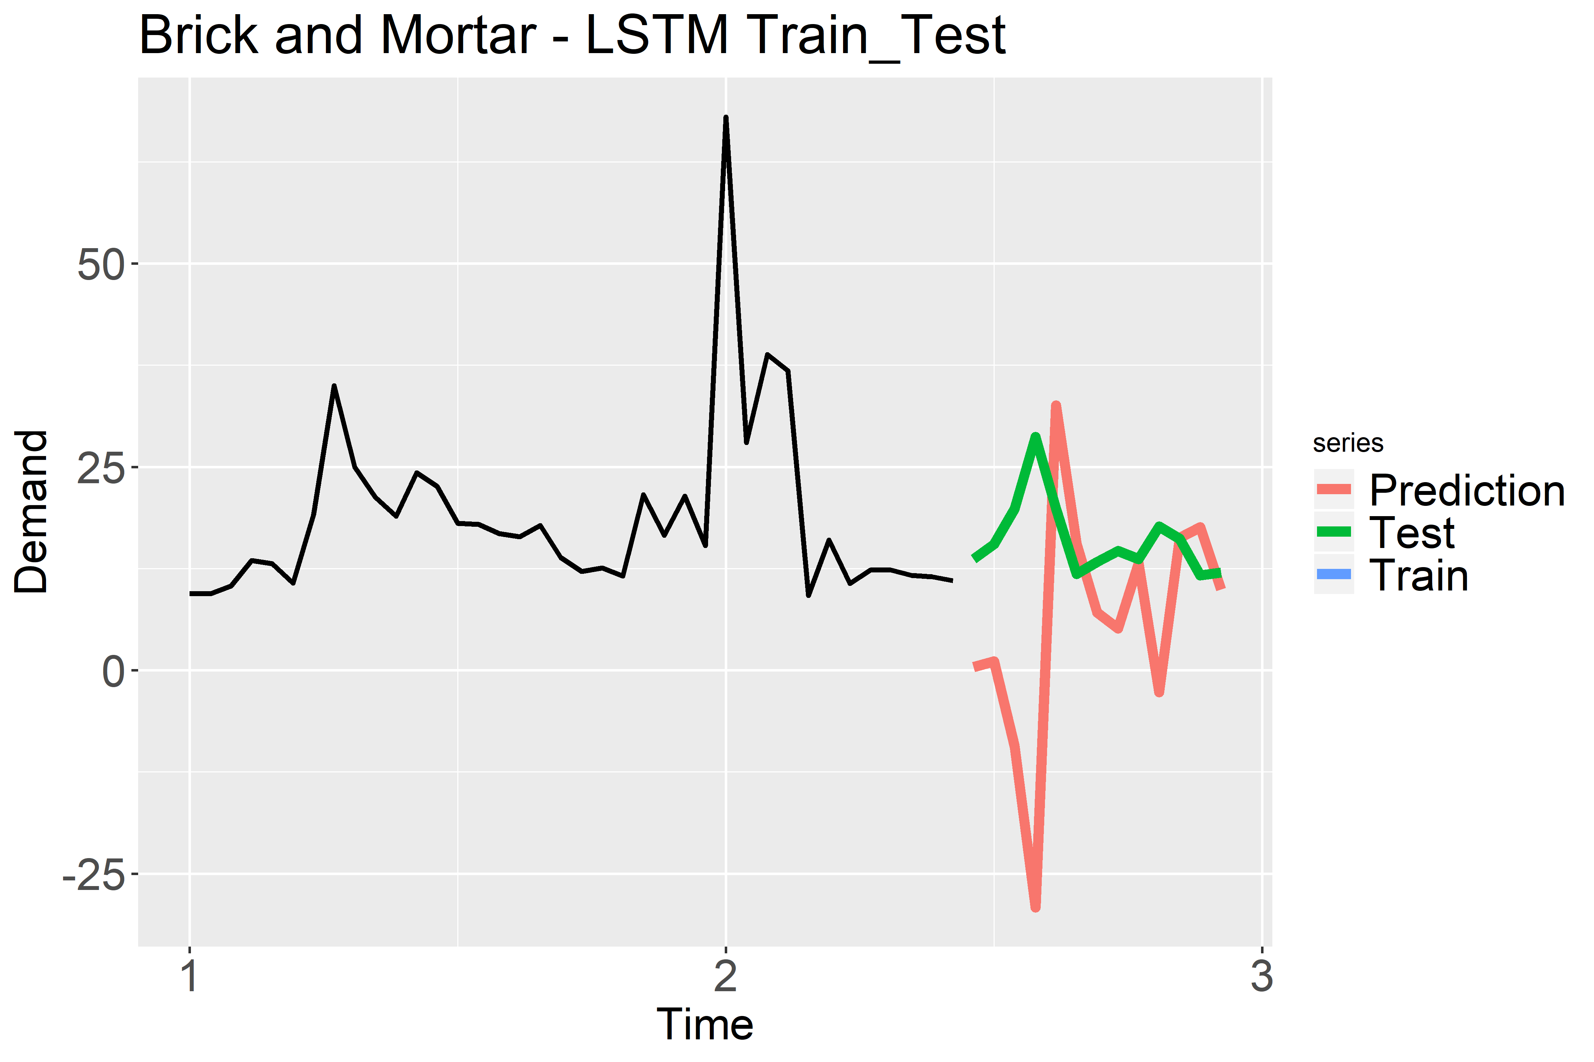
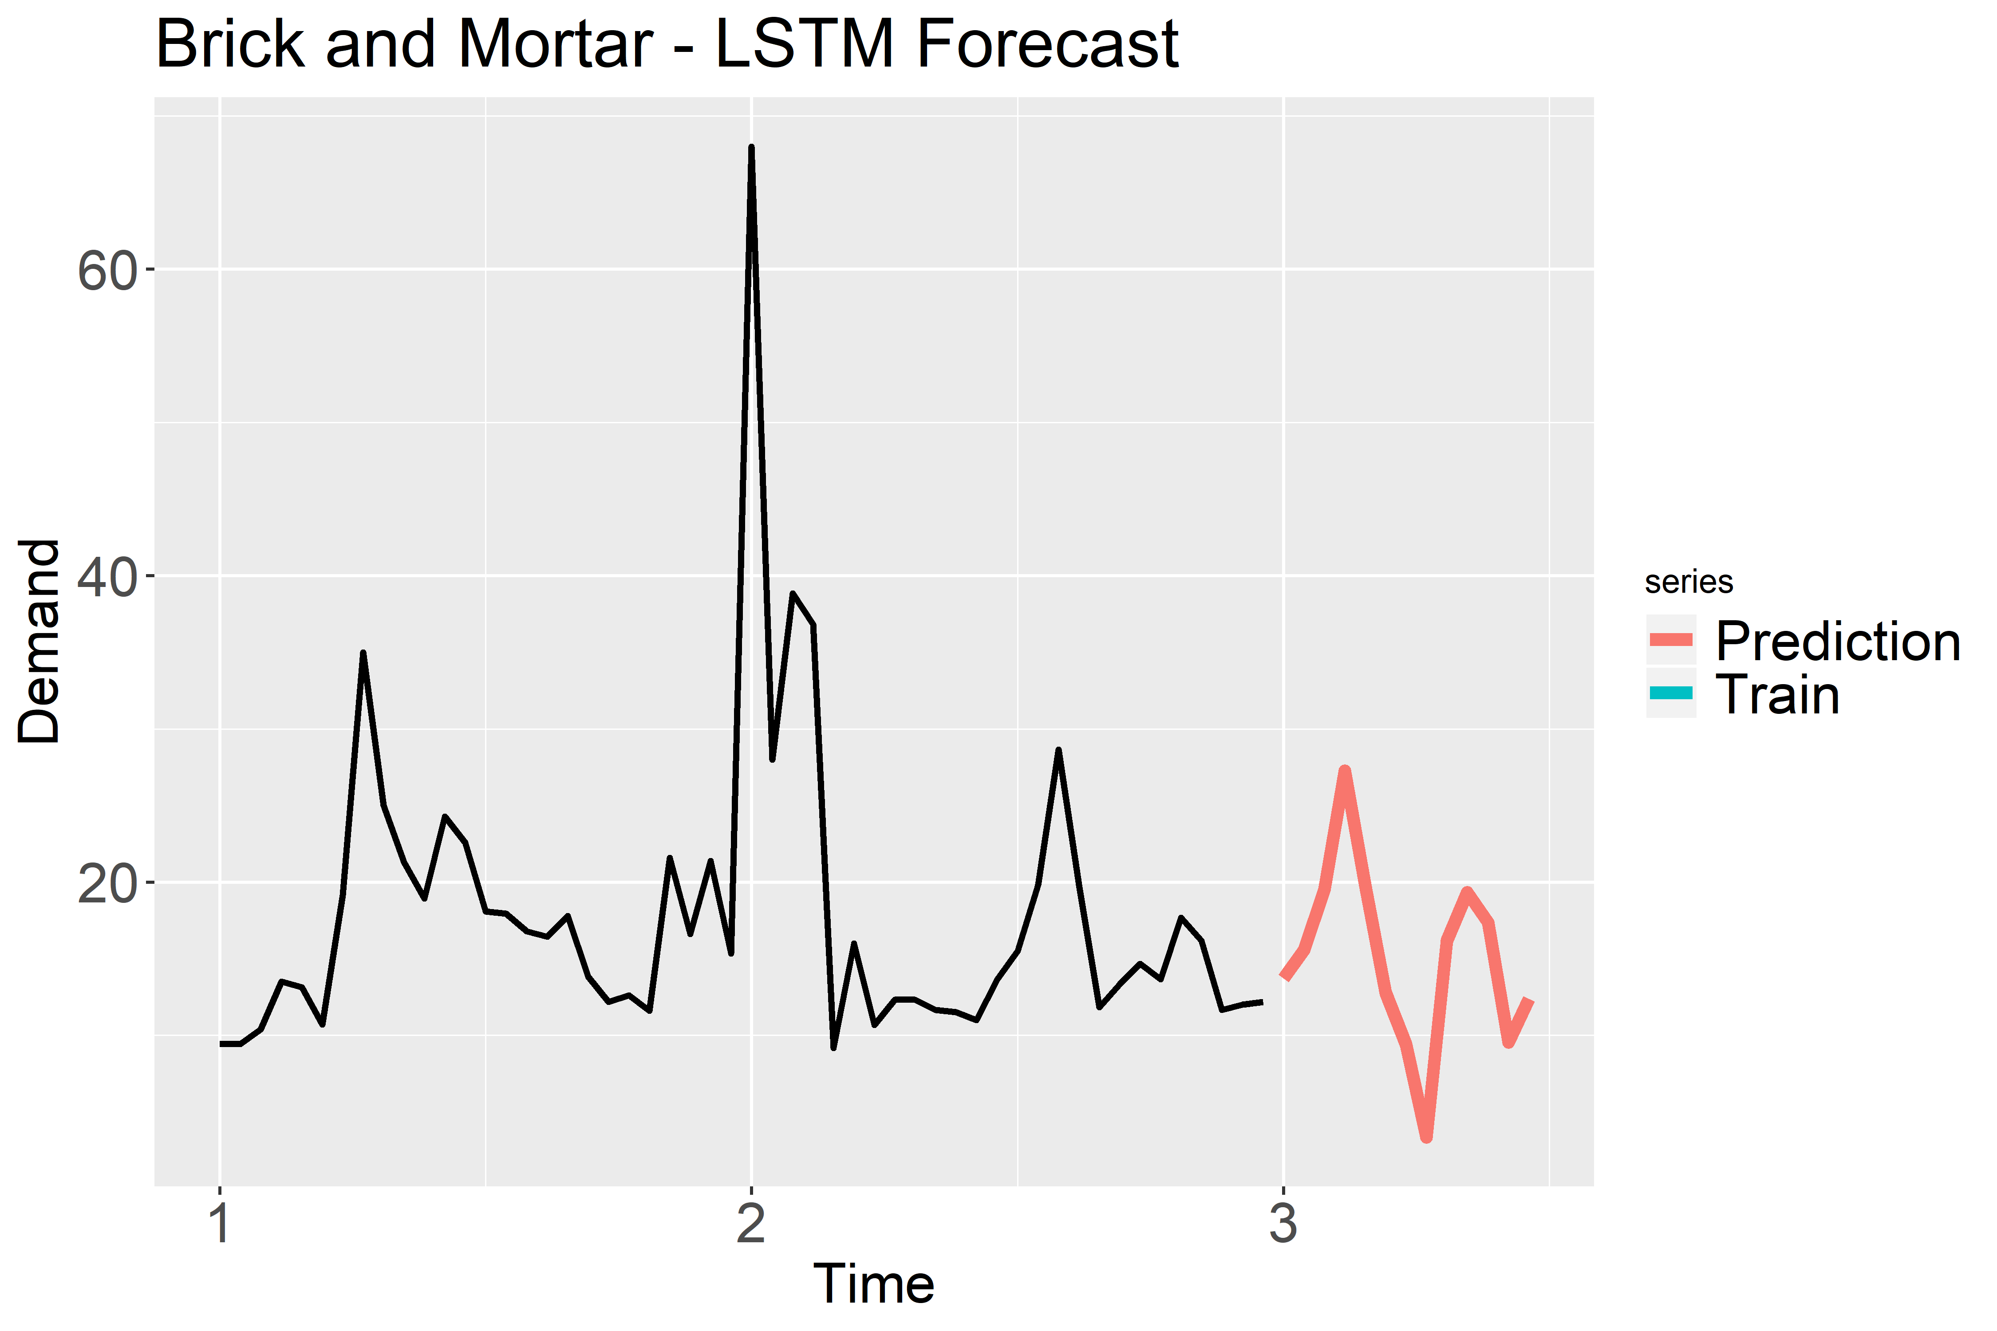
Brick and Mortar - STYLE329_BLACK_40GEAR
Legend
Time 1: January 2018
Time 2: January 2019
Time 3: January 2020

Slide 36
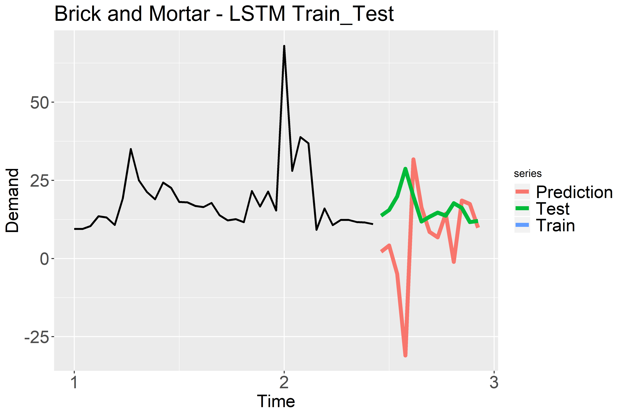

Brick and Mortar – STYLE366_BLACK_------
Legend
Time 1: January 2018
Time 2: January 2019
Time 3: January 2020

Slide 37
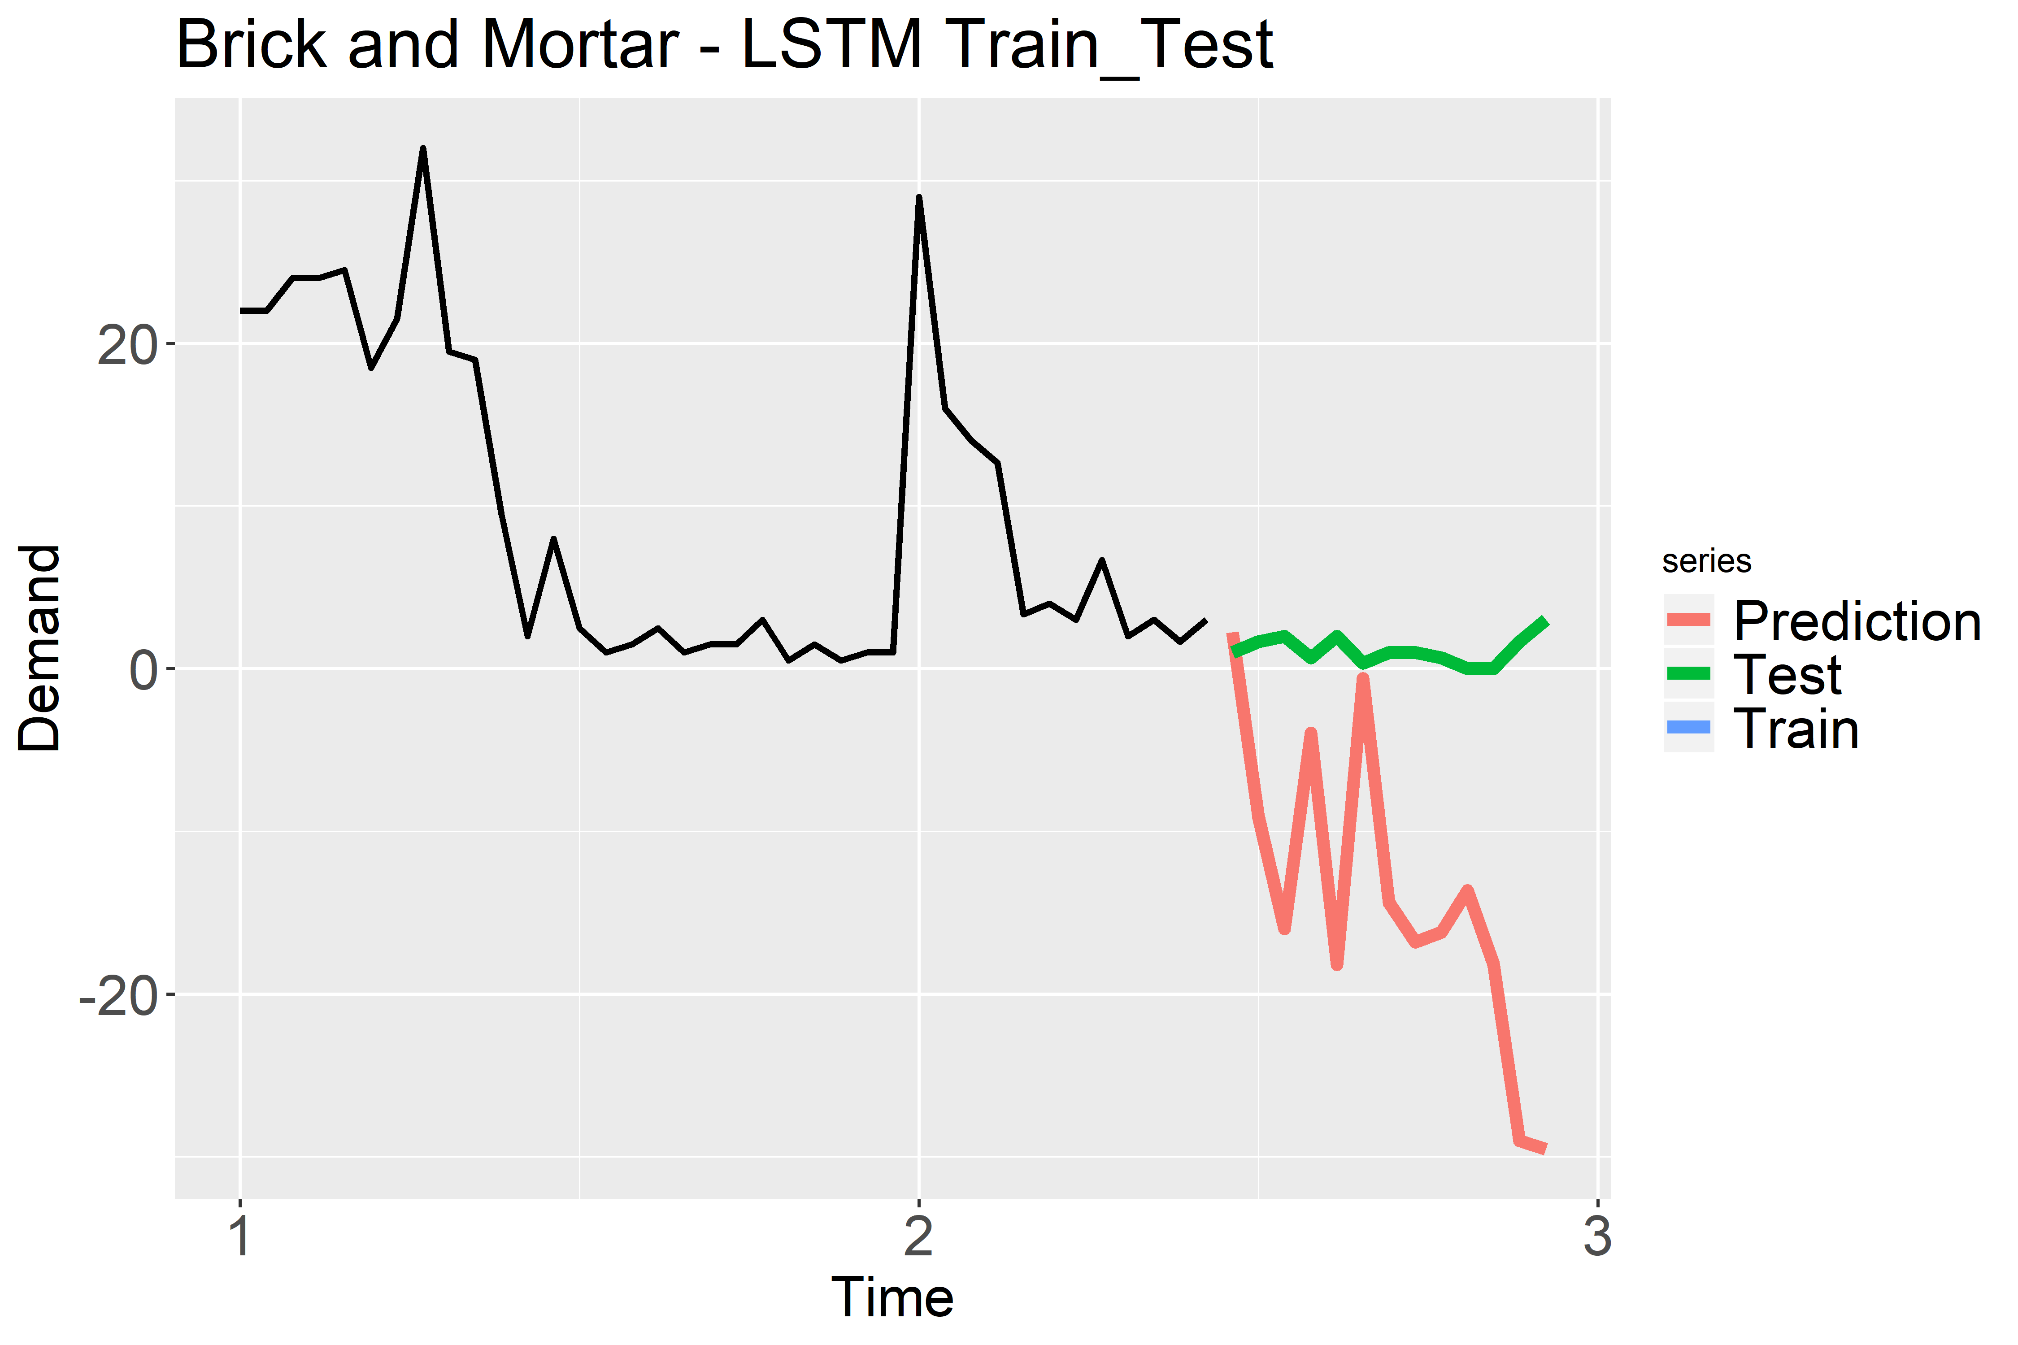
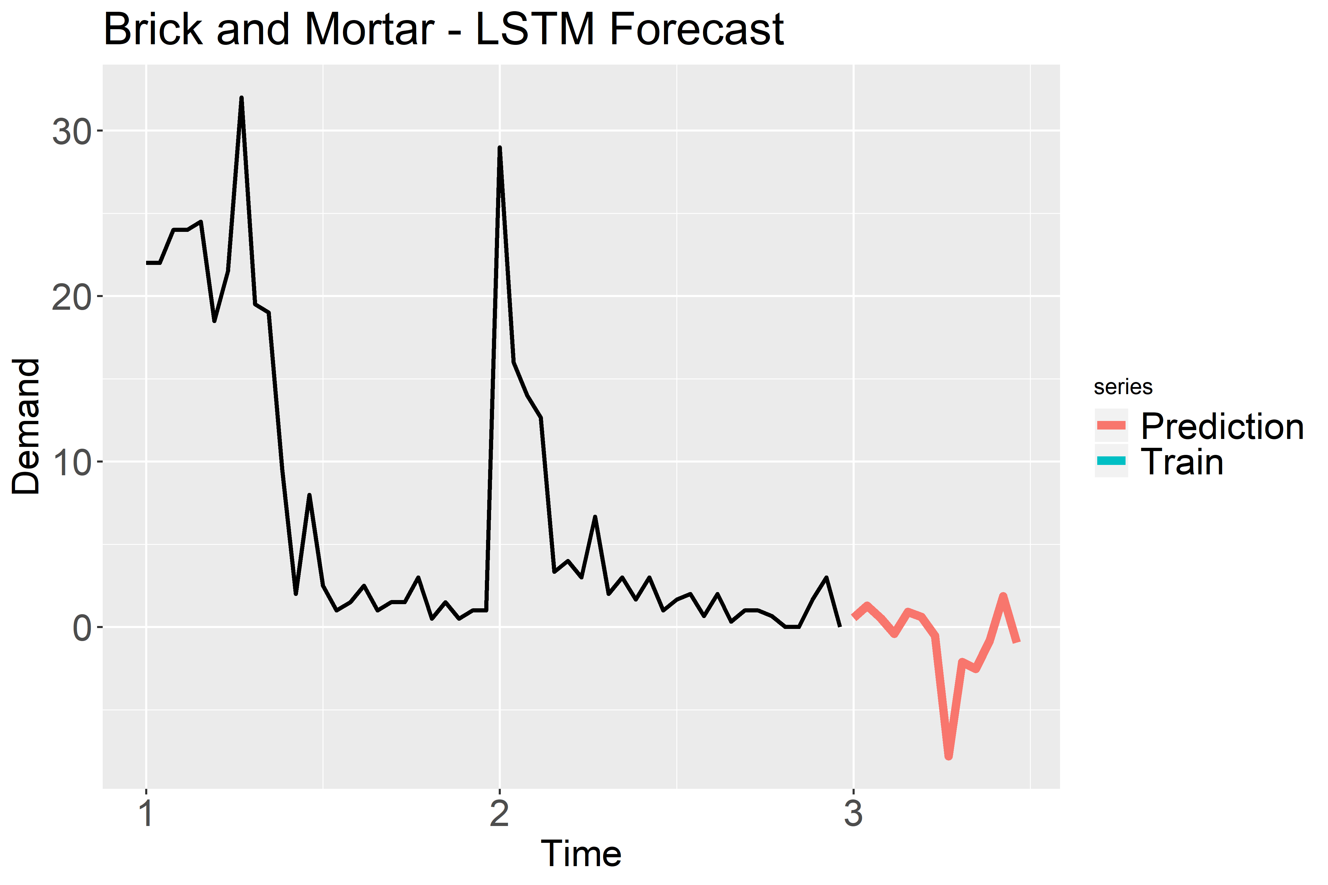
Brick and Mortar – STYLE203_GREY_549314
Legend
Time 1: January 2018
Time 2: January 2019
Time 3: January 2020

Slide 38
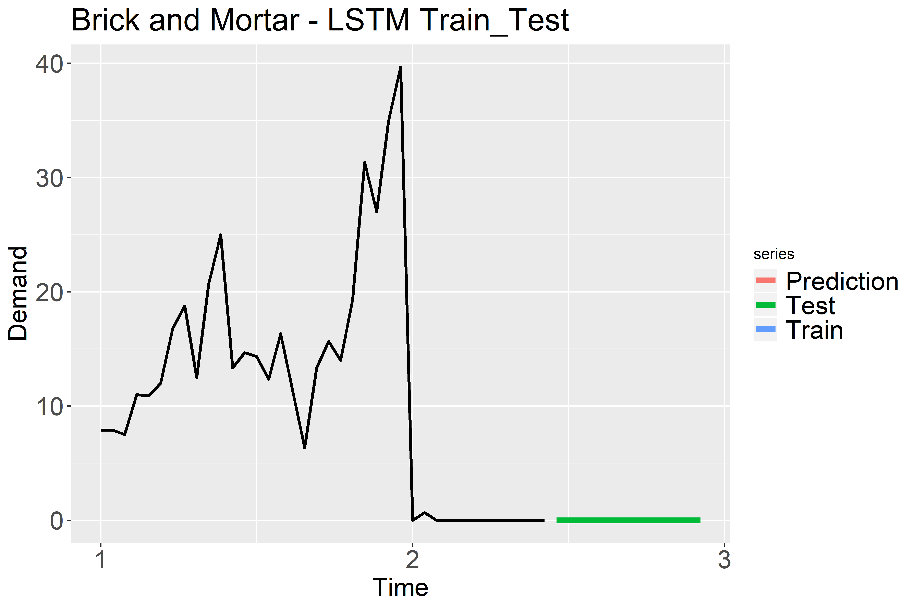
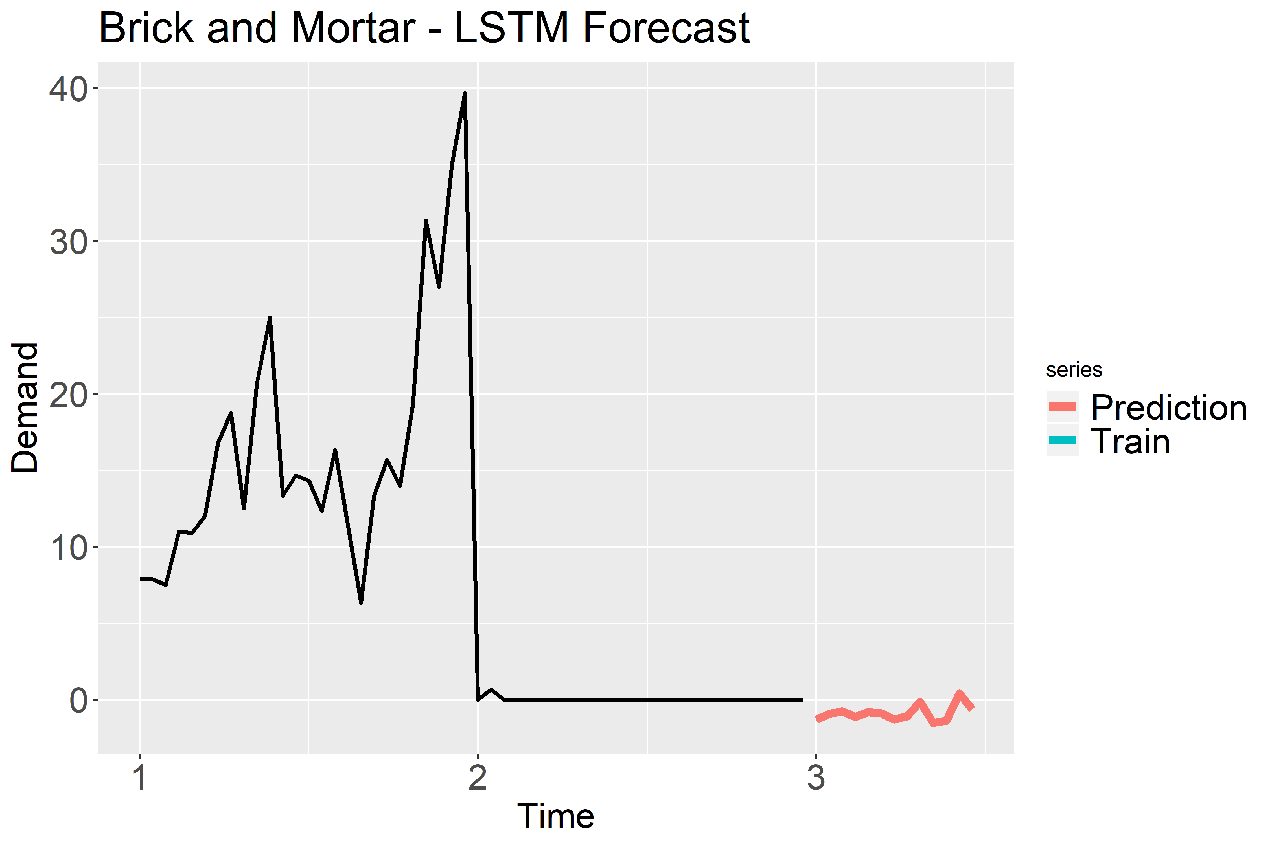
Brick and Mortar – STYLE264_RED_------
Legend
Time 1: January 2018
Time 2: January 2019
Time 3: January 2020

Slide 39
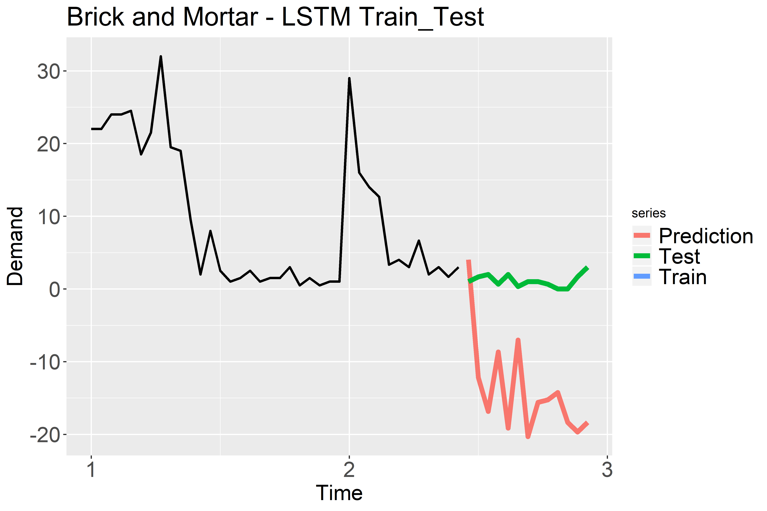
Brick and Mortar – STYLE276_BLACK_549333
Legend
Time 1: January 2018
Time 2: January 2019
Time 3: January 2020

Slide 40
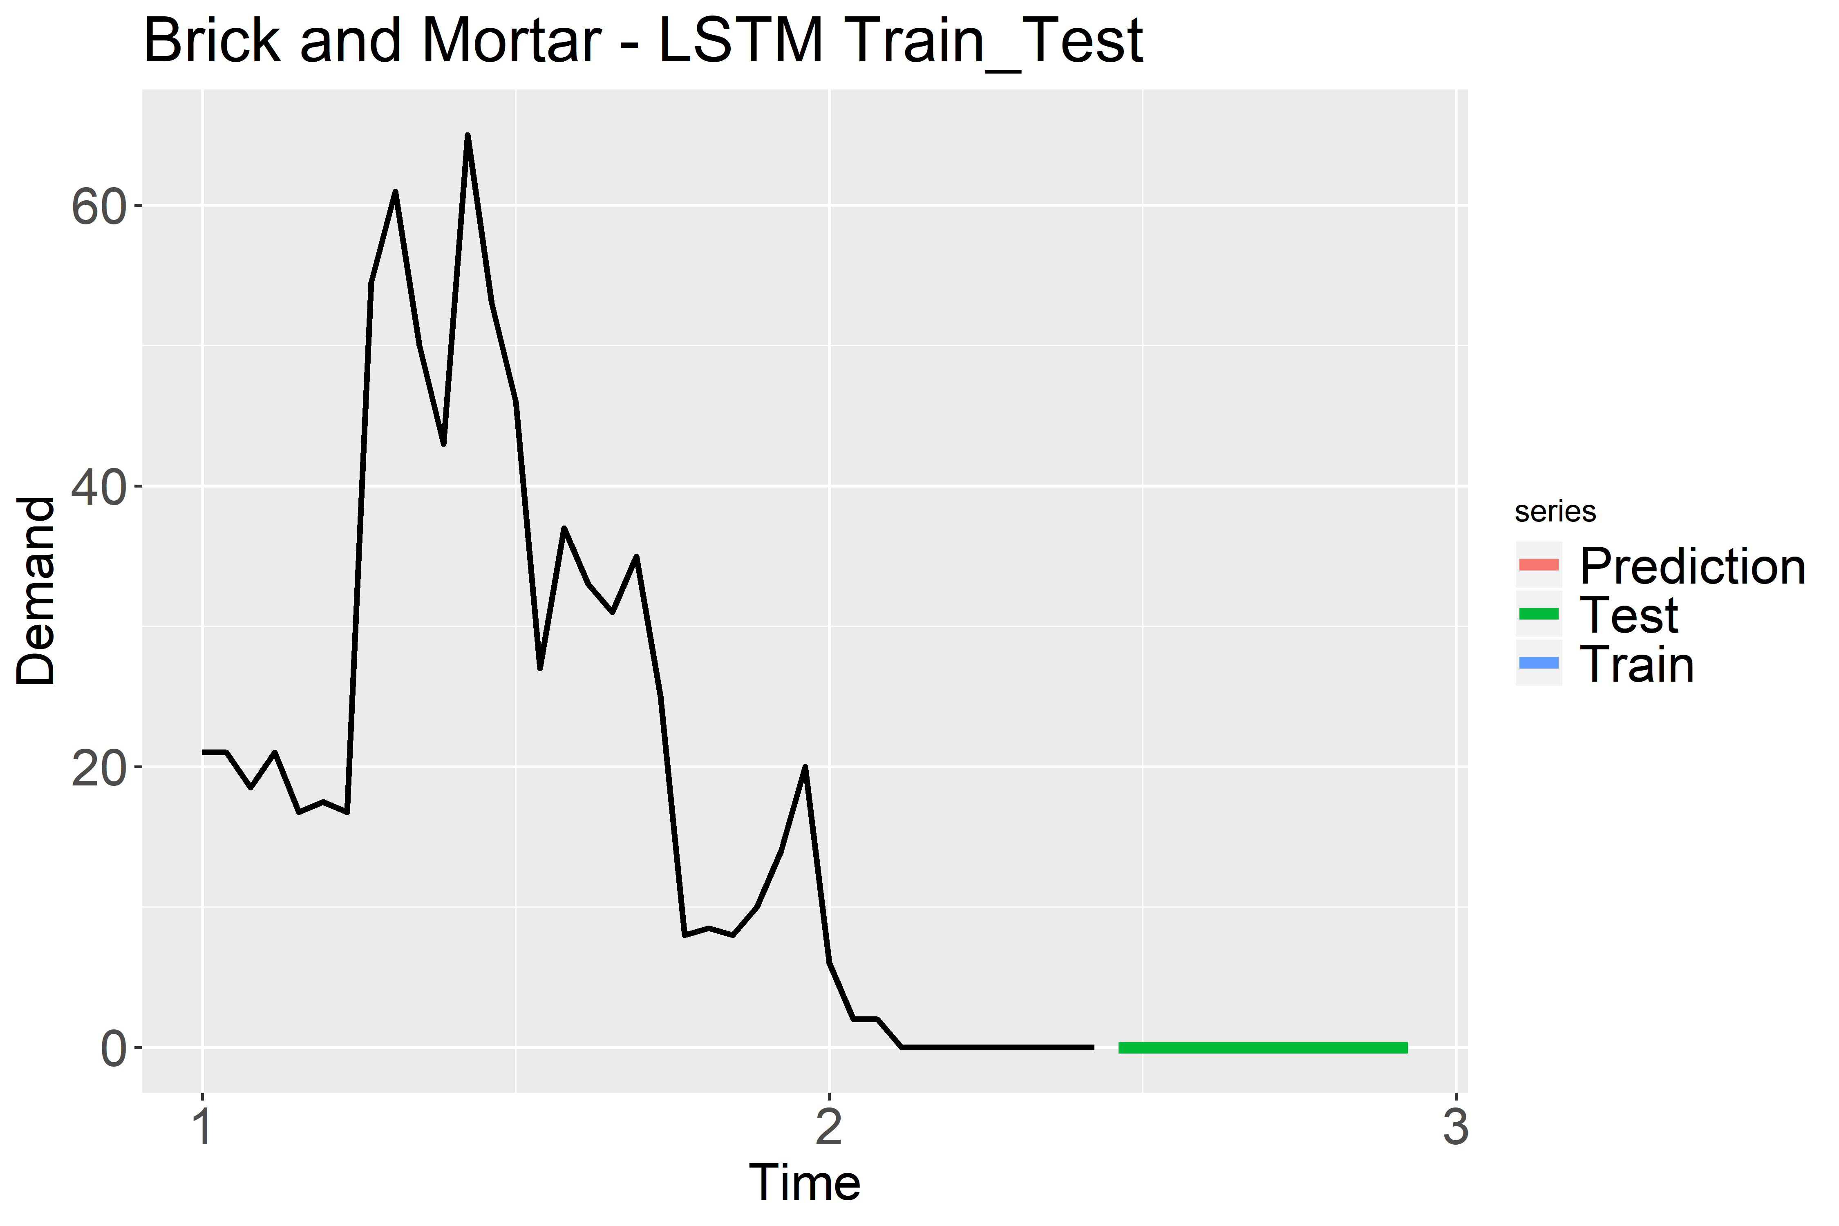
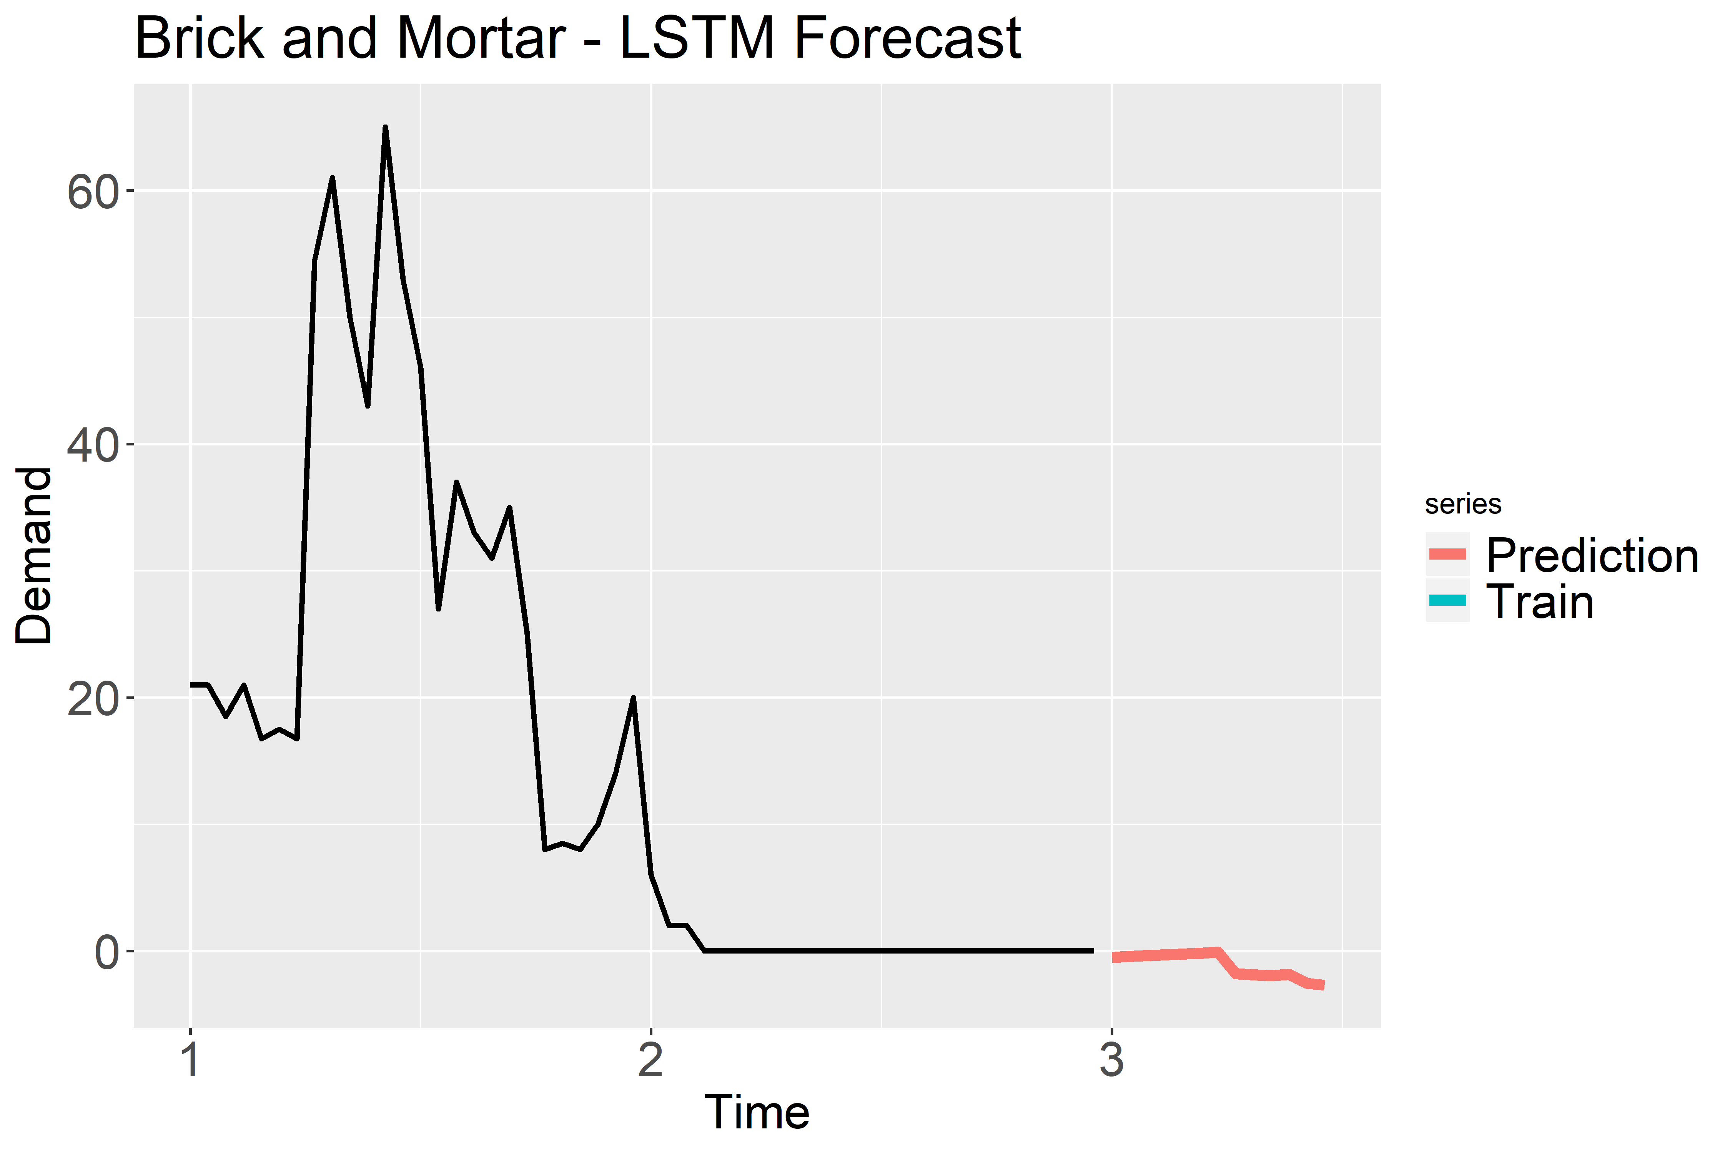
Brick and Mortar – STYLE359_BLUE_------
Legend
Time 1: January 2018
Time 2: January 2019
Time 3: January 2020

Slide 41
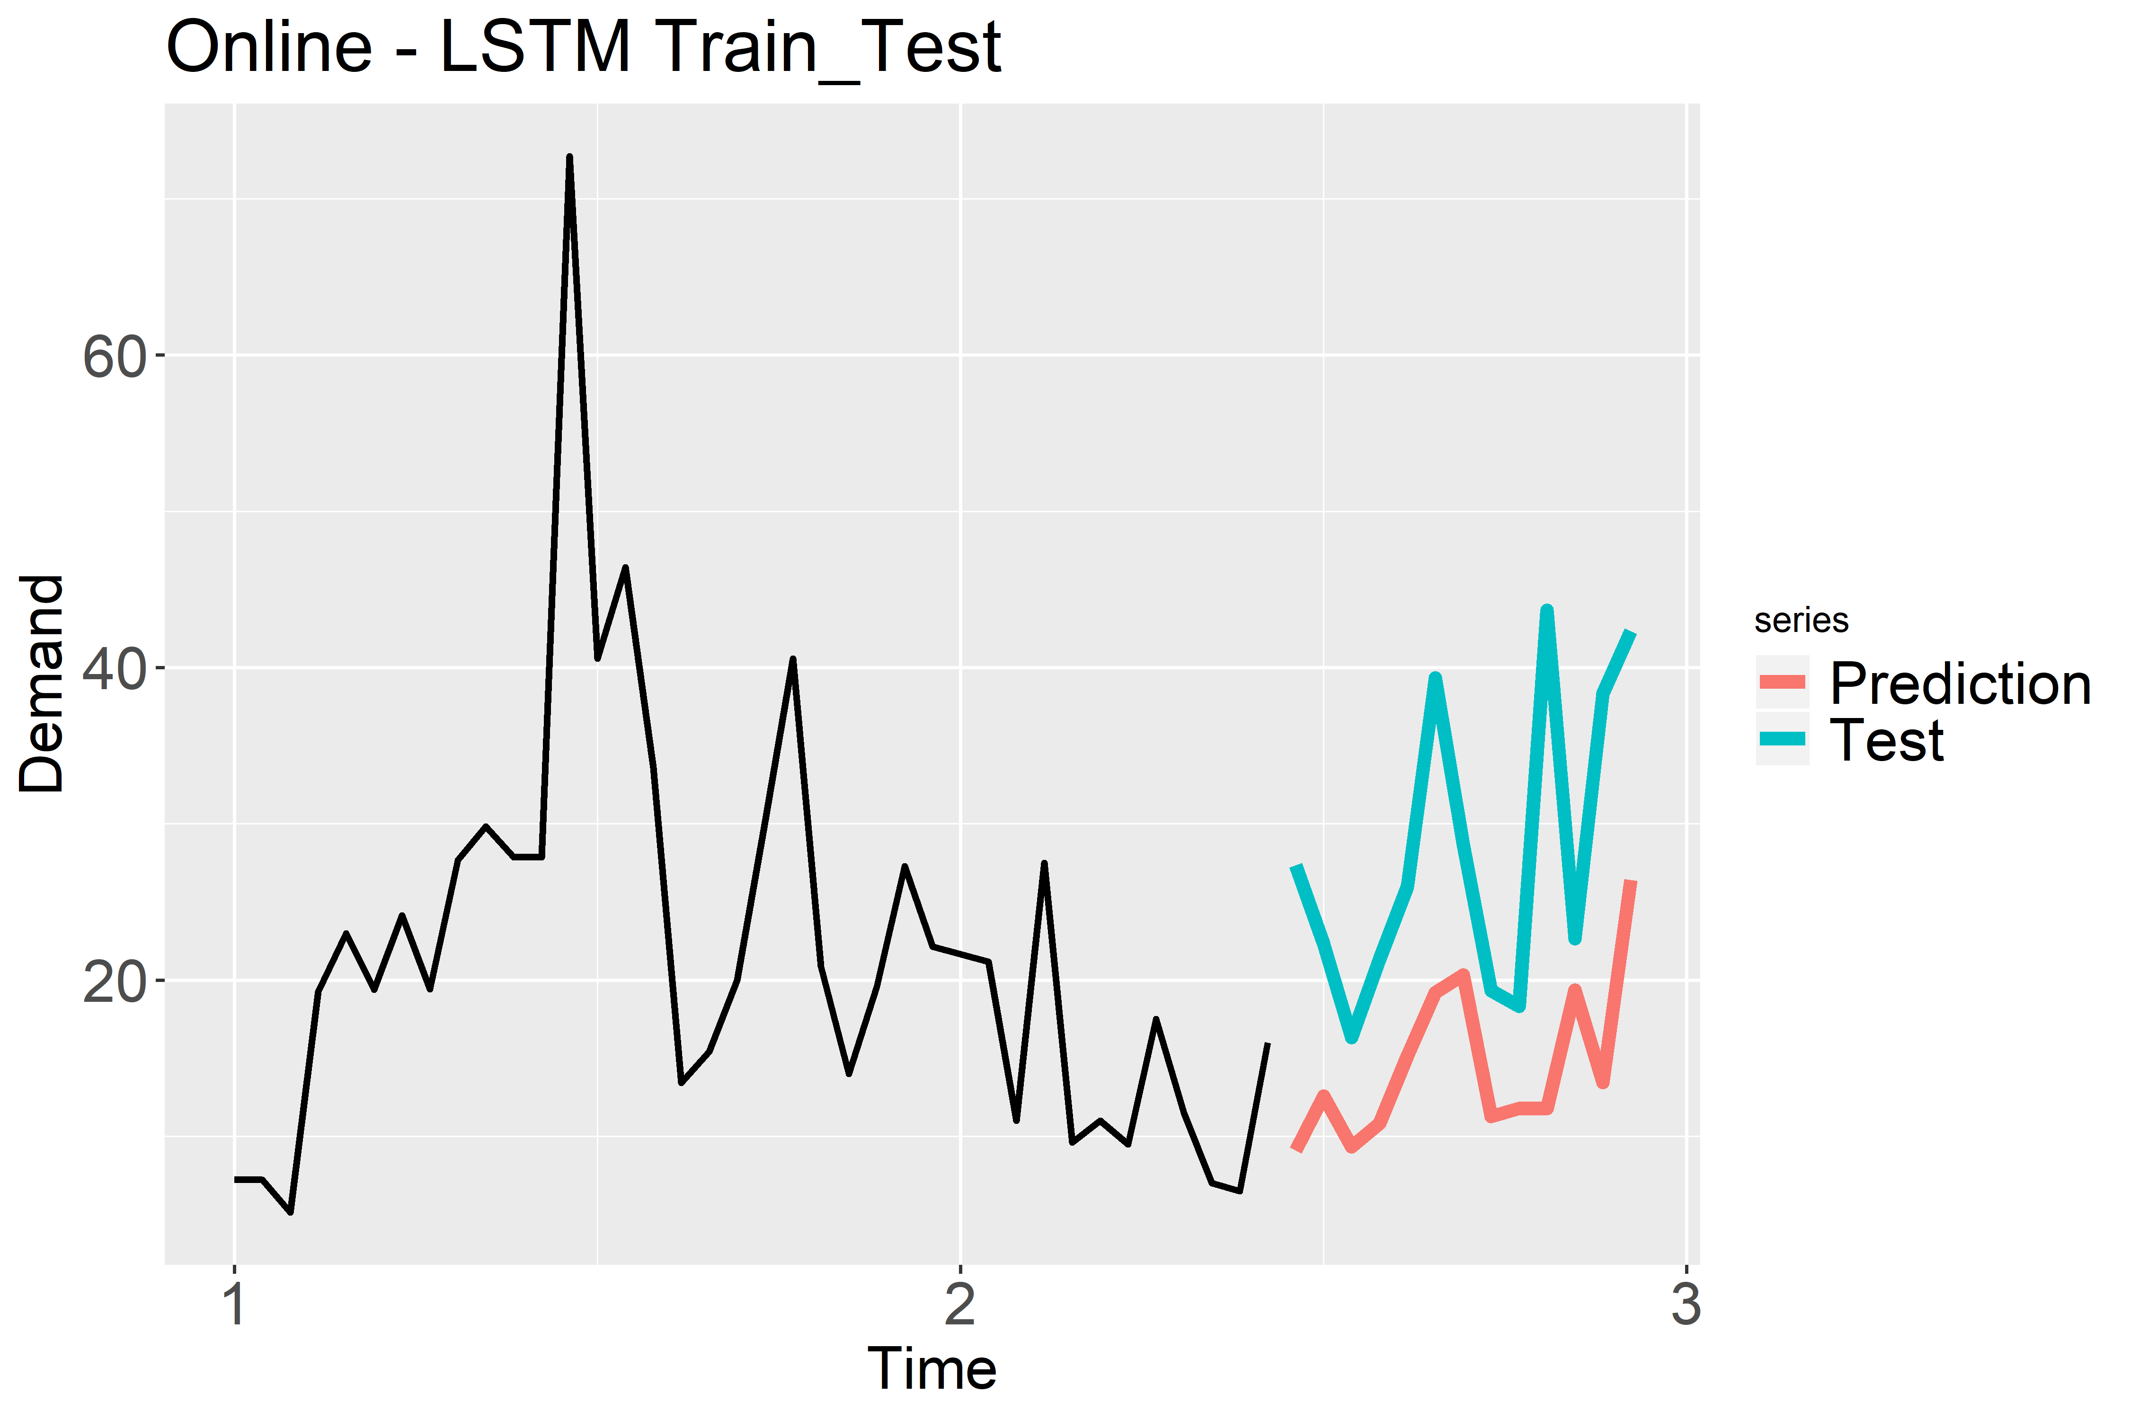
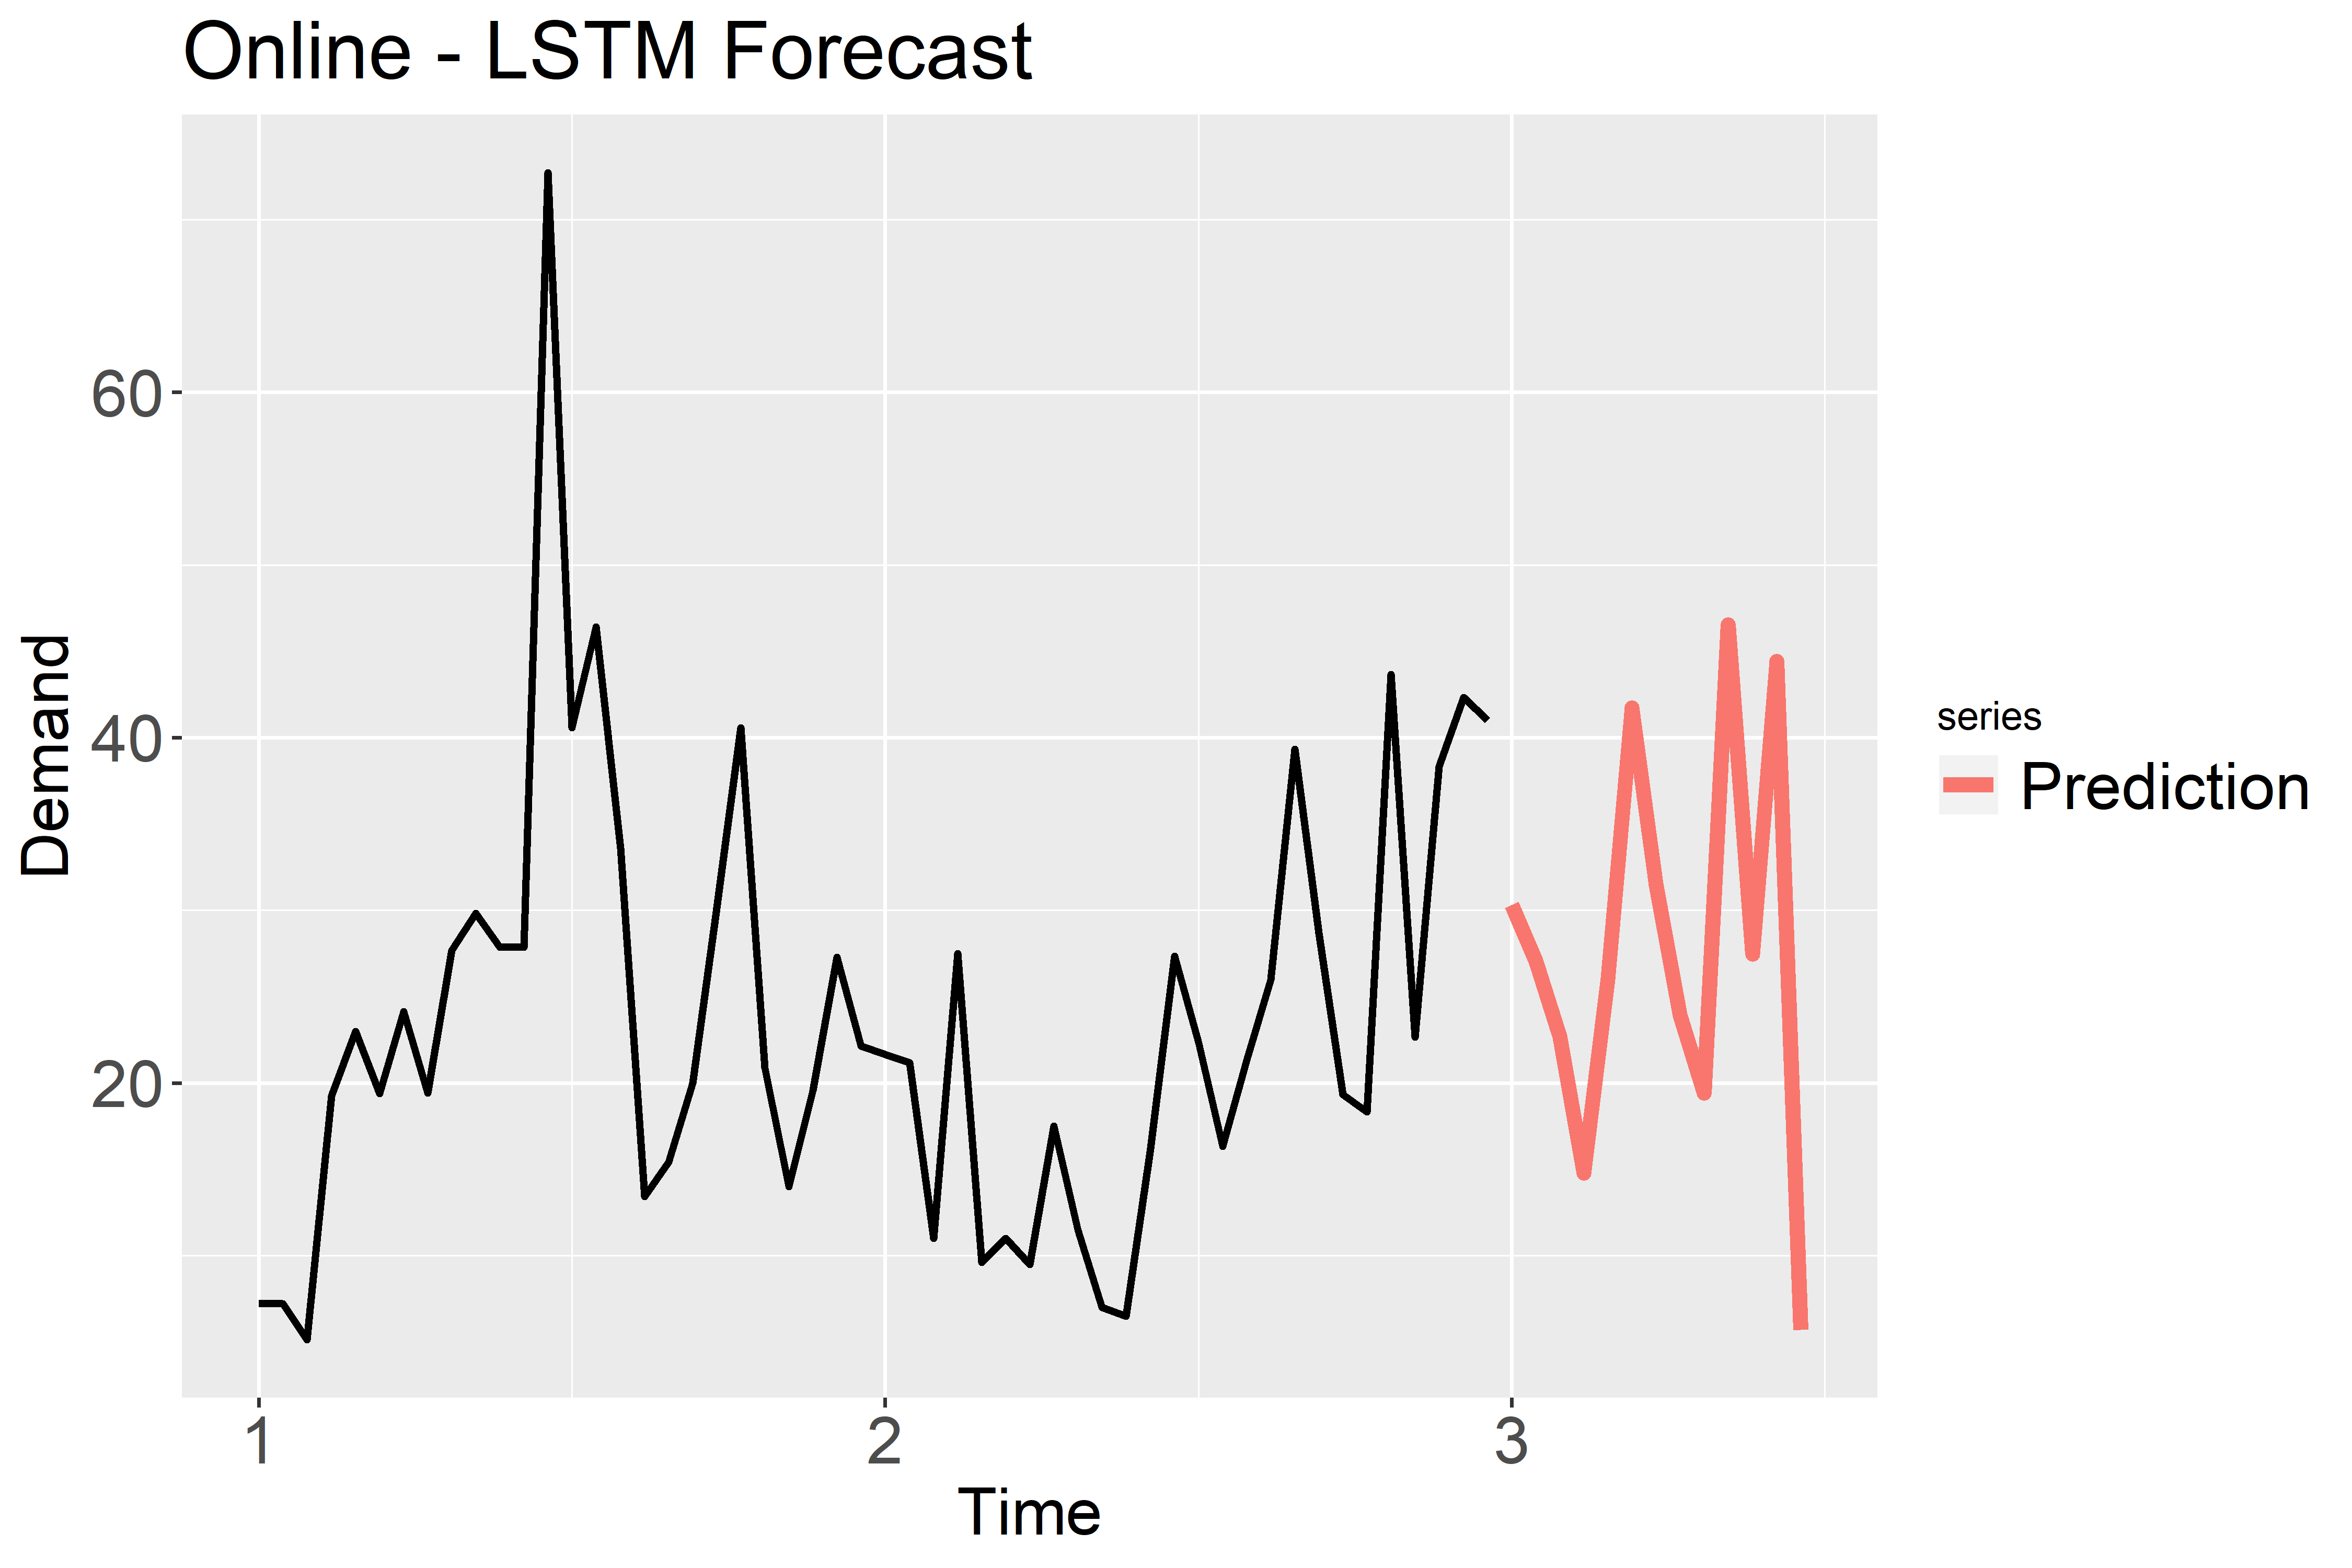
Online - STYLE031_BLACK_407Q88
Legend
Time 1: January 2018
Time 2: January 2019
Time 3: January 2020

Slide 42
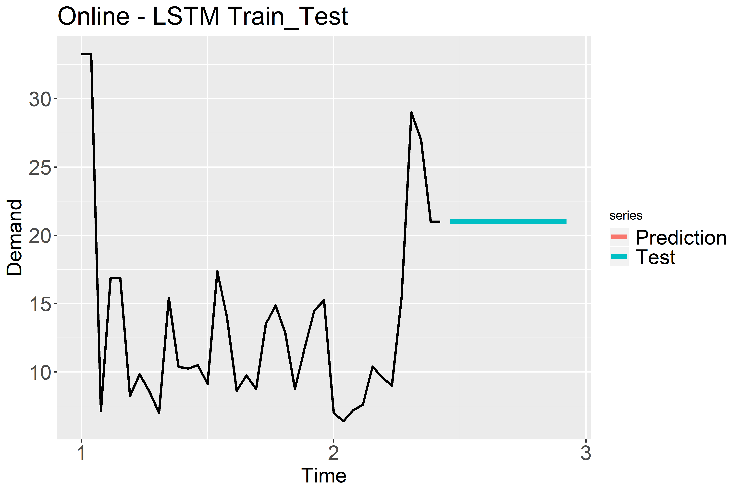
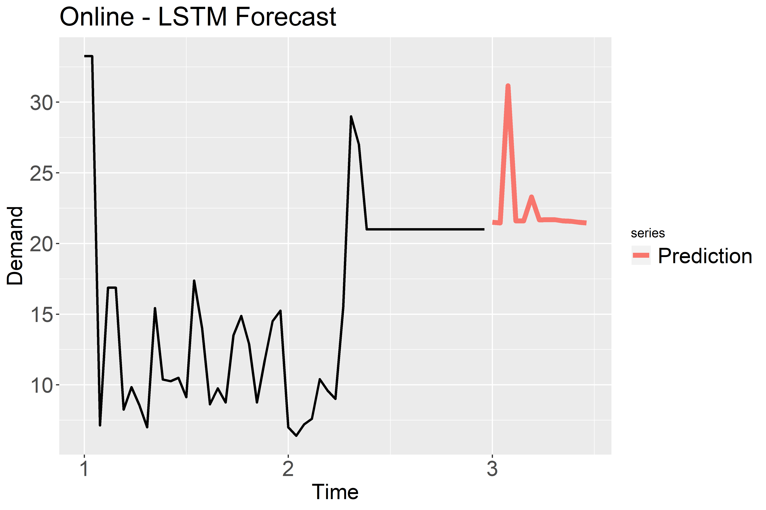
Online - STYLE082_WHITE_------
Legend
Time 1: January 2018
Time 2: January 2019
Time 3: January 2020

Slide 43
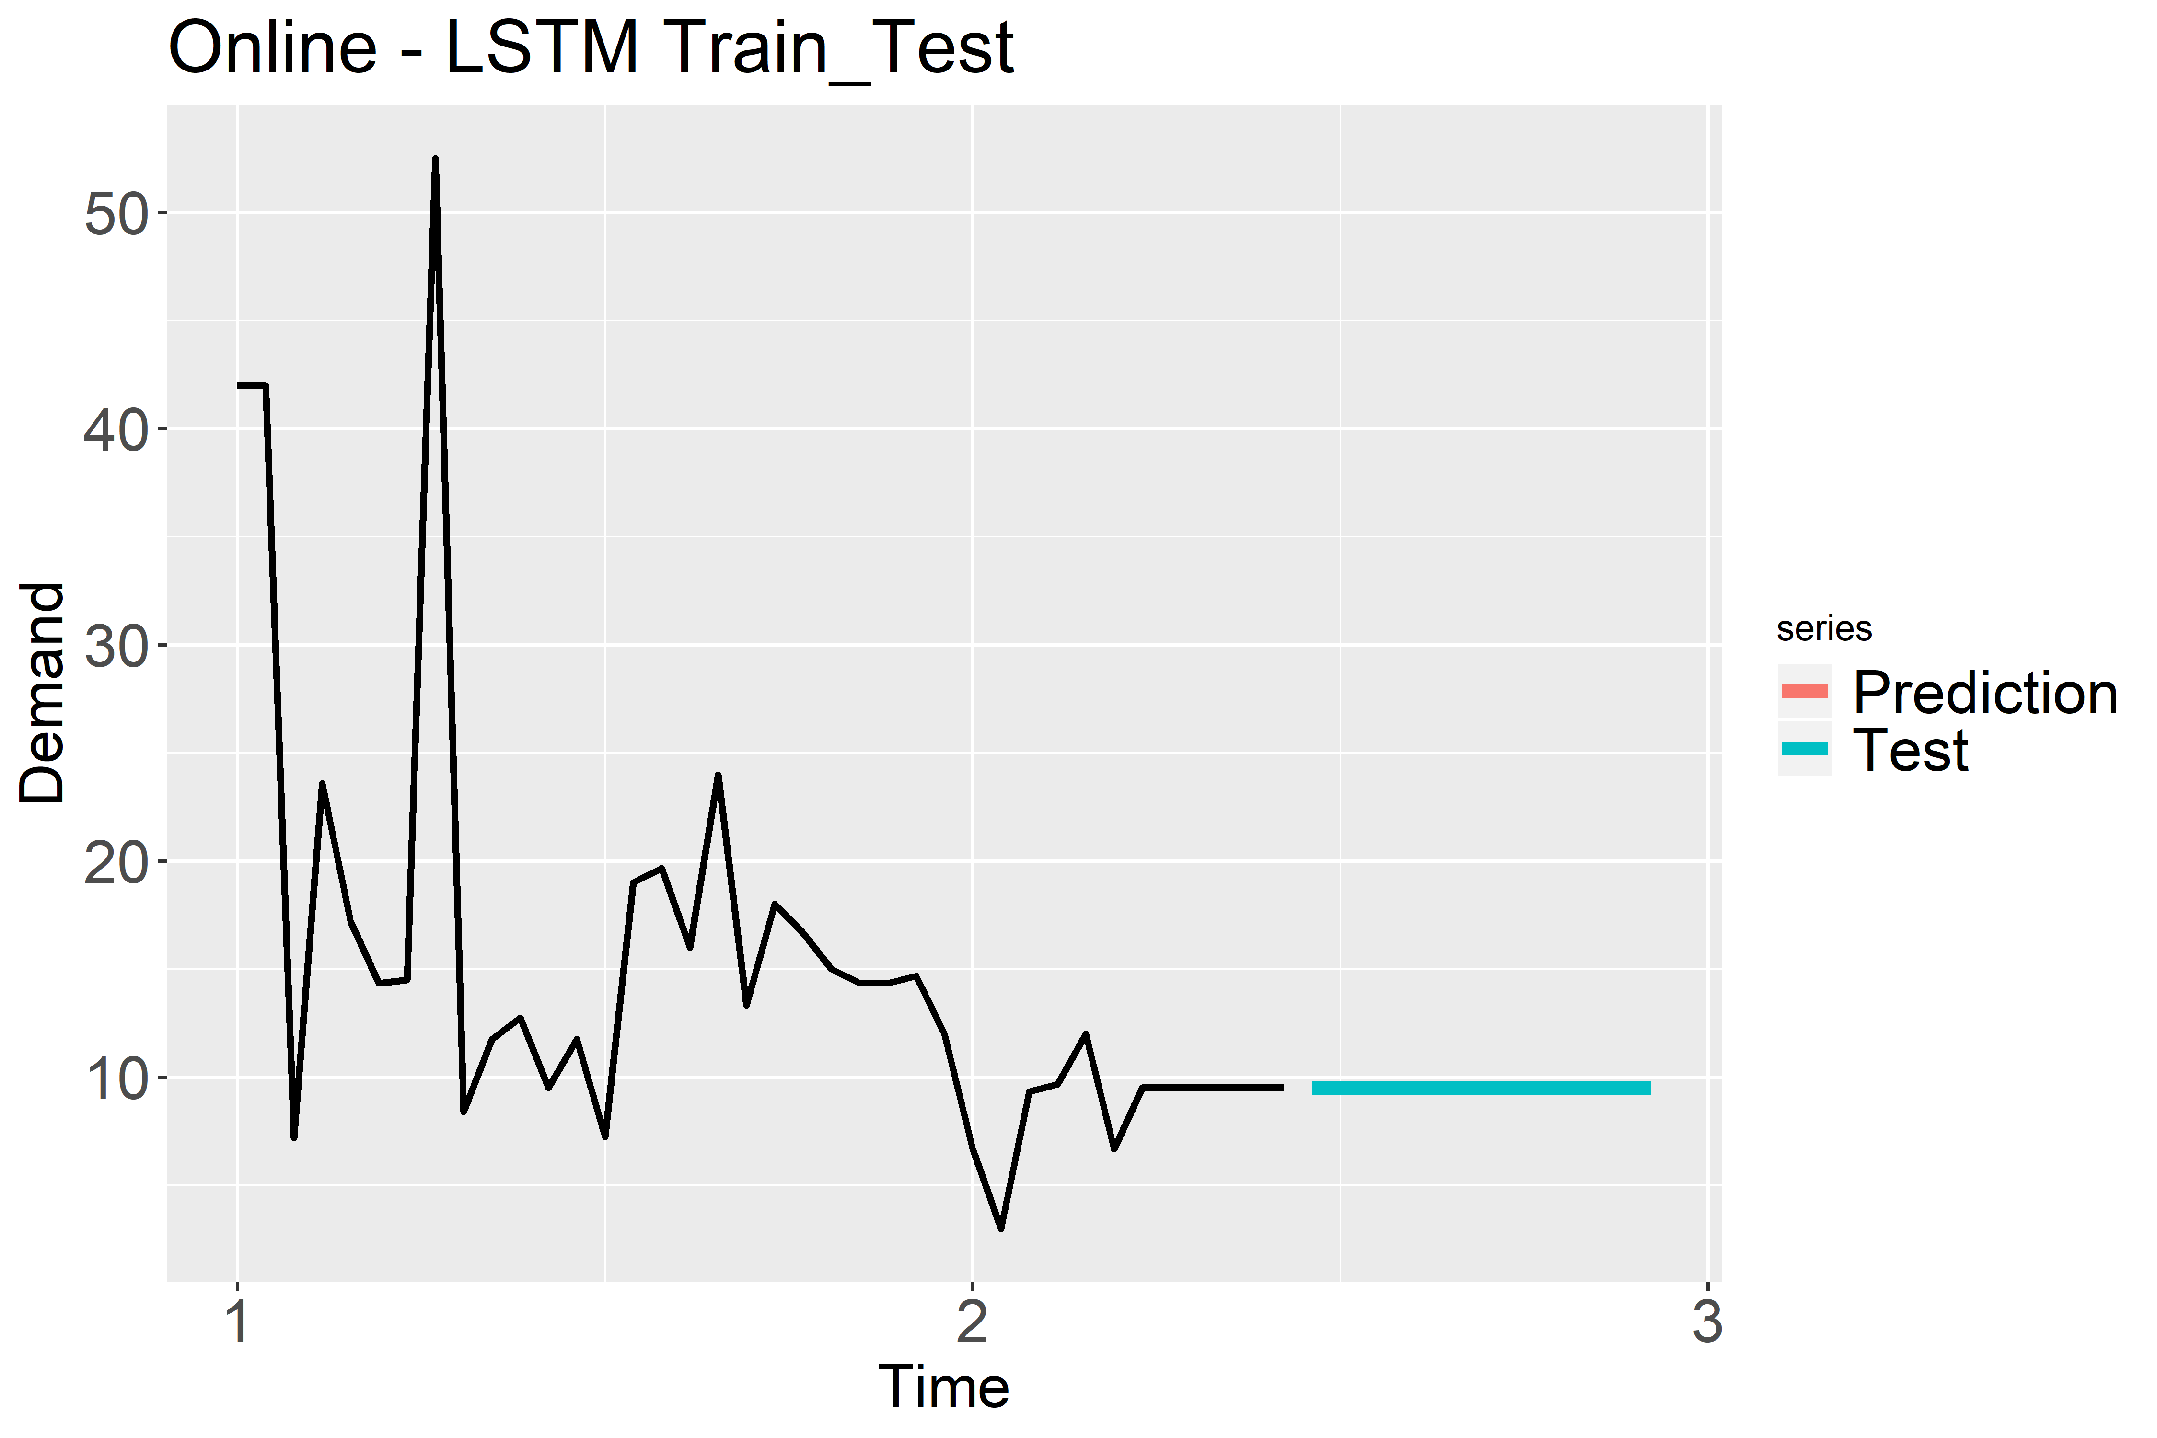
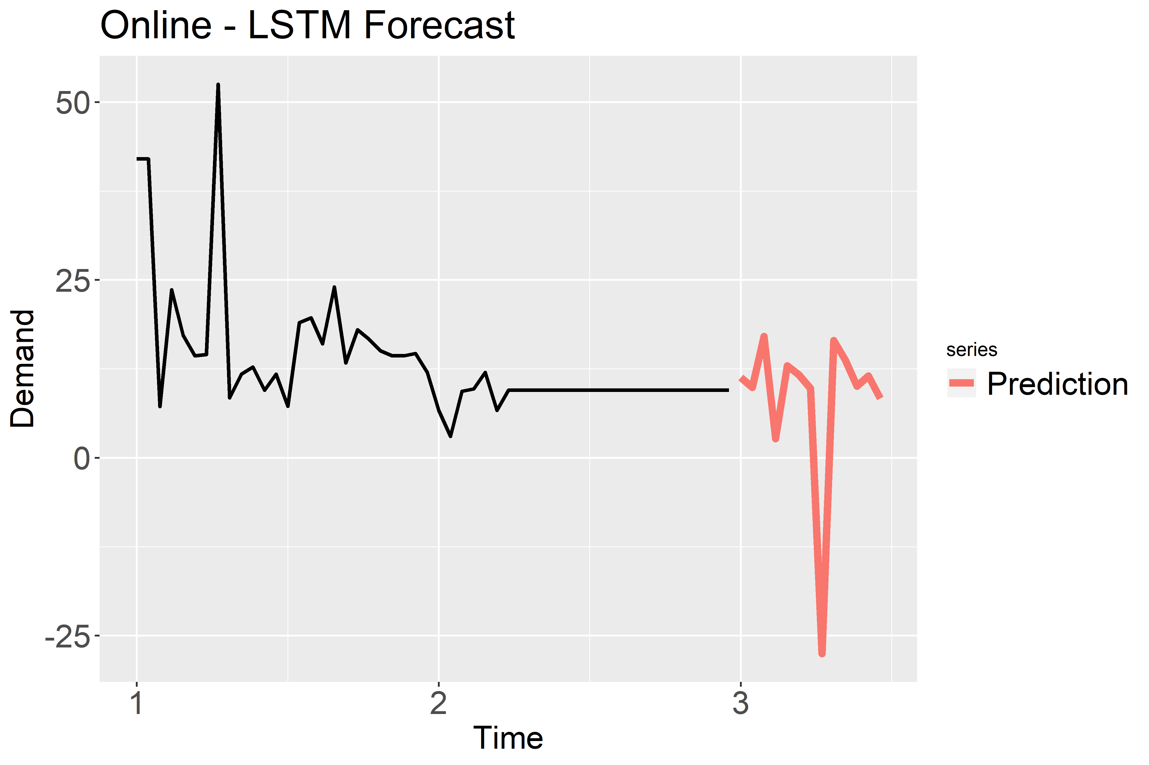
Online - STYLE087_GREY_------
Legend
Time 1: January 2018
Time 2: January 2019
Time 3: January 2020

Slide 44
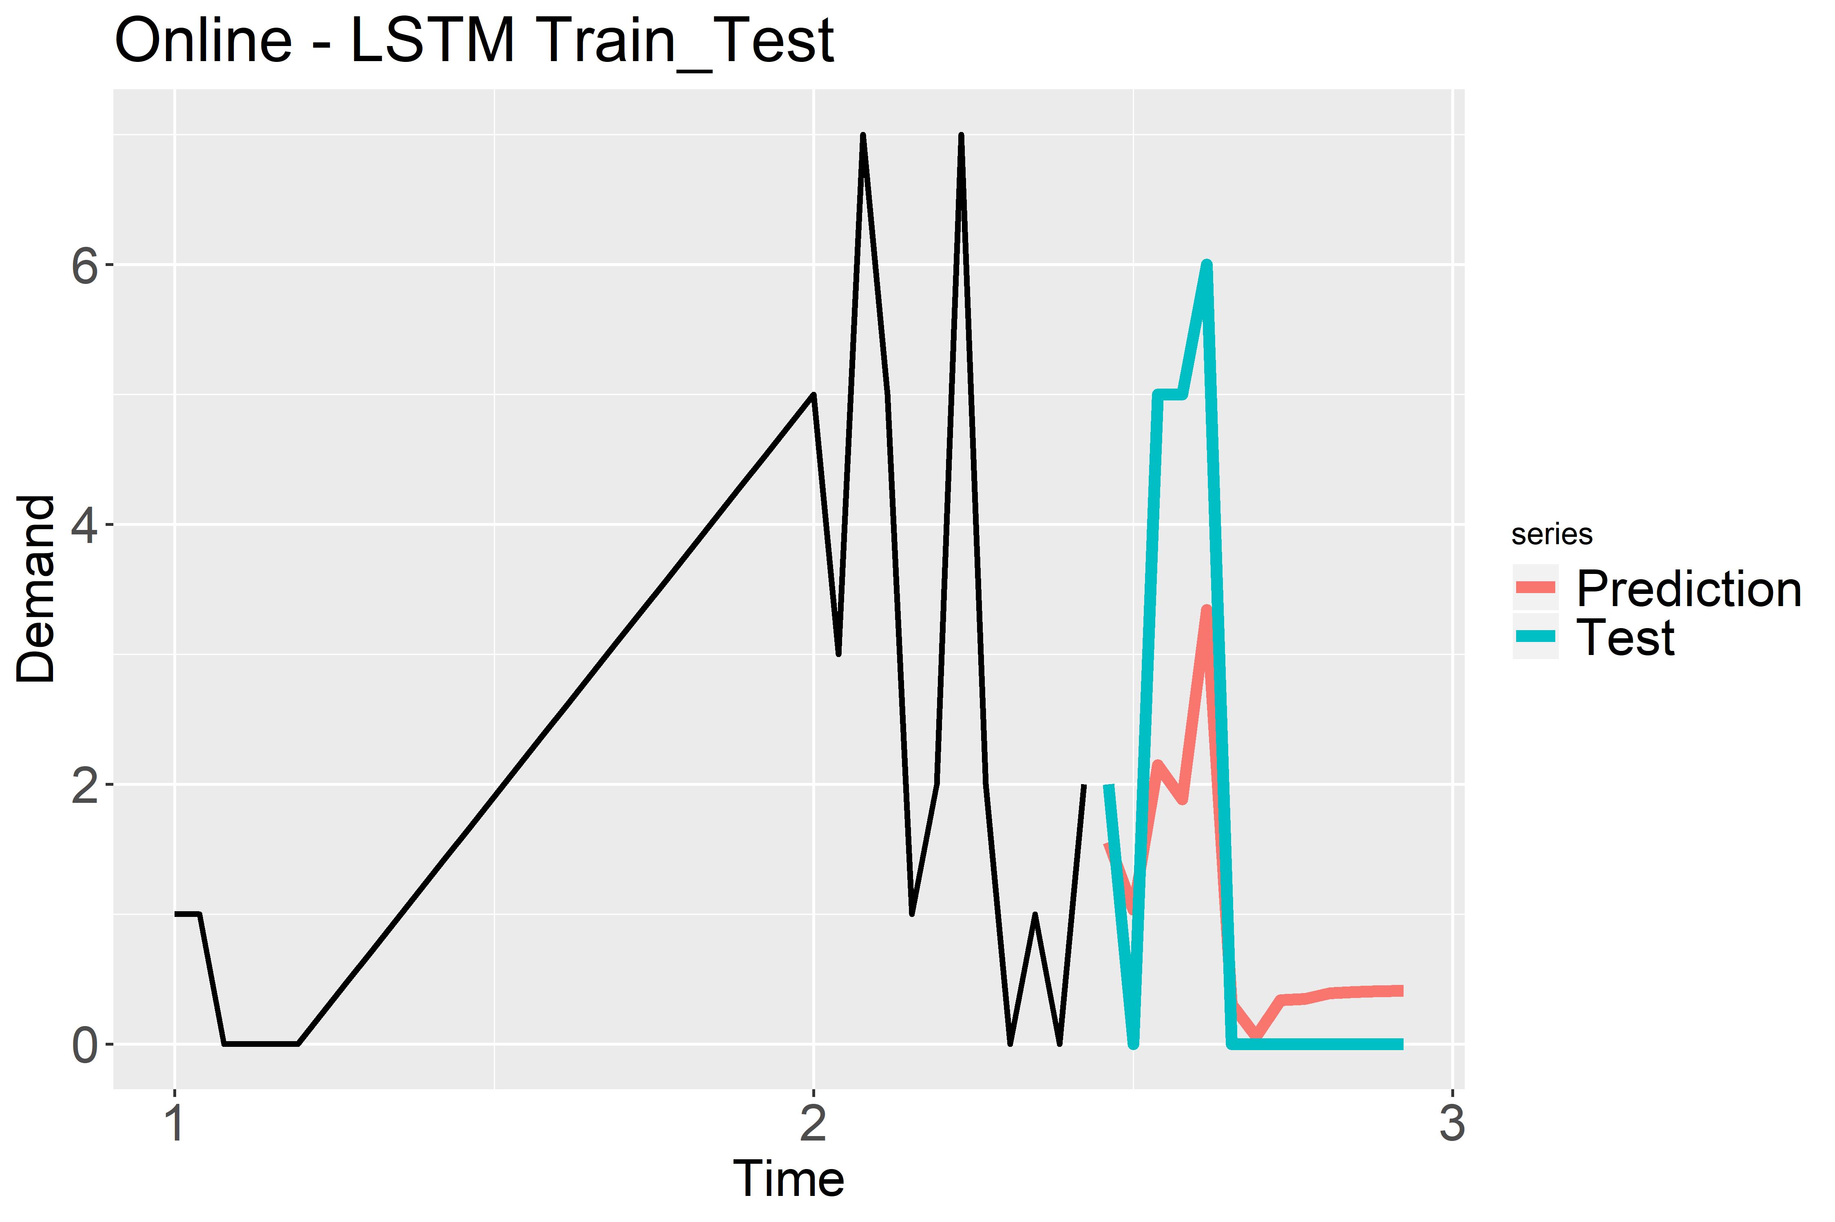
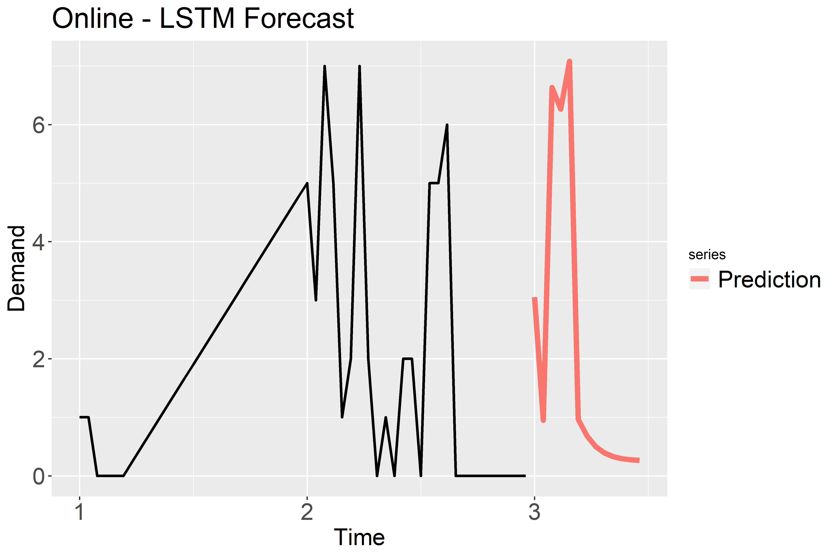
Online - STYLE104_BLUE_Y06085
Legend
Time 1: January 2018
Time 2: January 2019
Time 3: January 2020

Slide 45
Online - STYLE105_PURPLE_Y06145
Legend
Time 1: January 2018
Time 2: January 2019
Time 3: January 2020

Slide 46
Online - STYLE189_BLACK_------
Legend
Time 1: January 2018
Time 2: January 2019
Time 3: January 2020

Slide 47
Online - STYLE116_BLACK_549314
Legend
Time 1: January 2018
Time 2: January 2019
Time 3: January 2020

Slide 48
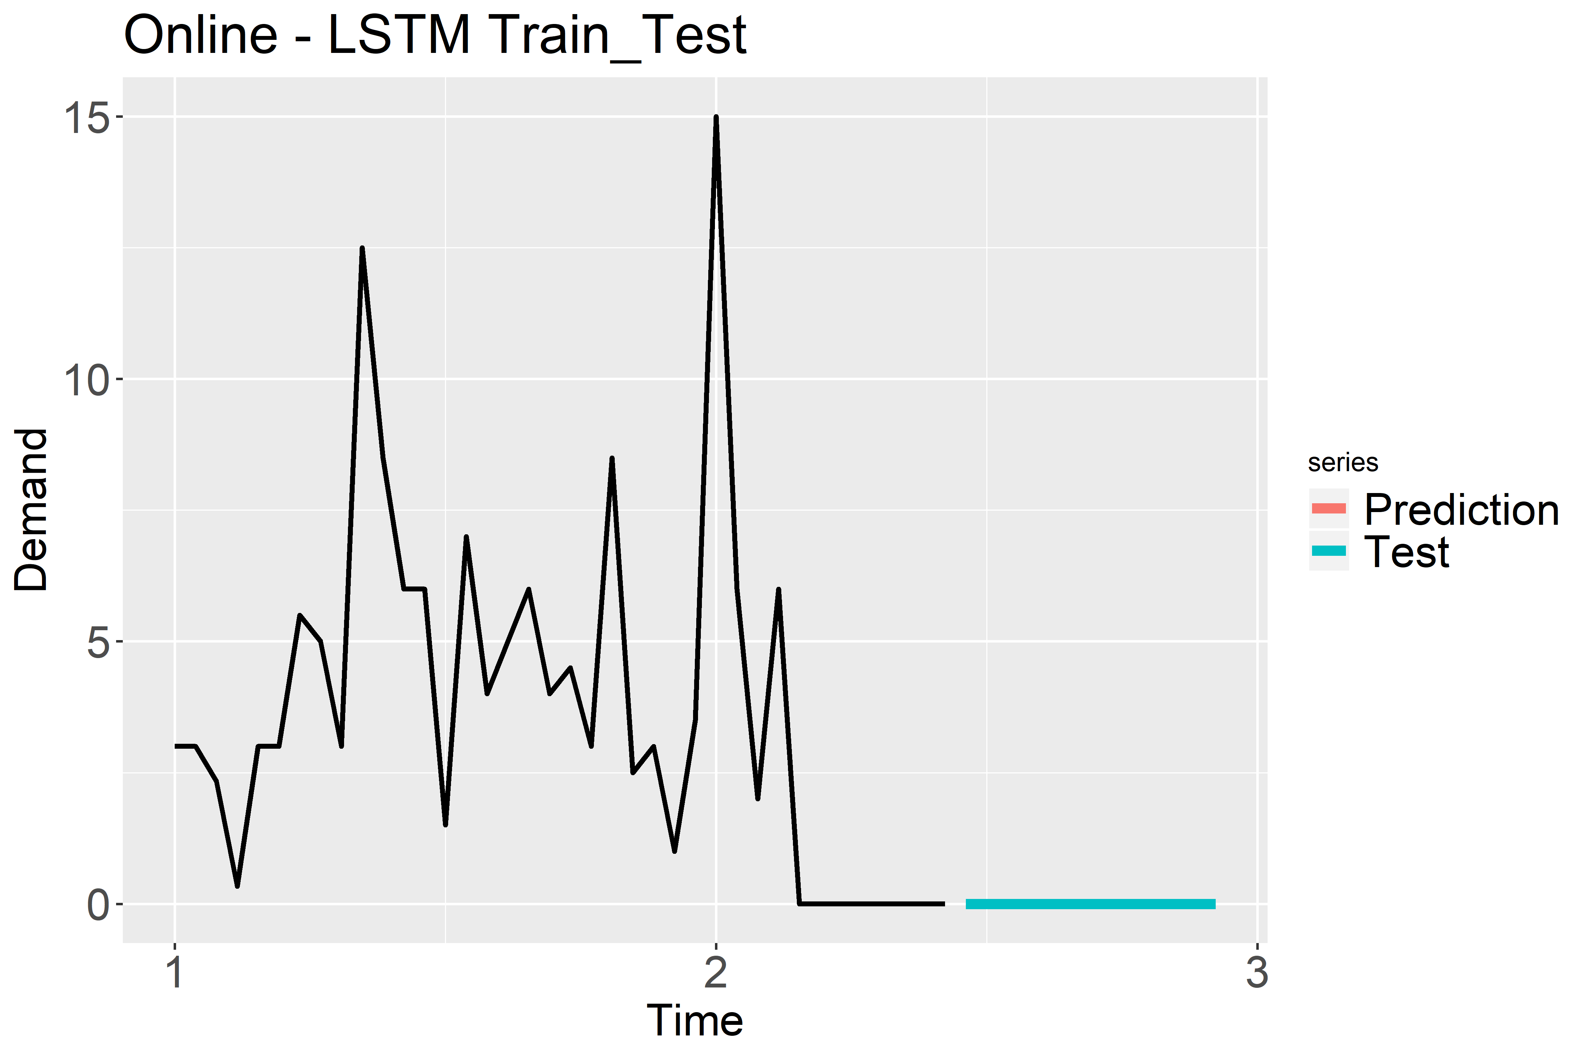
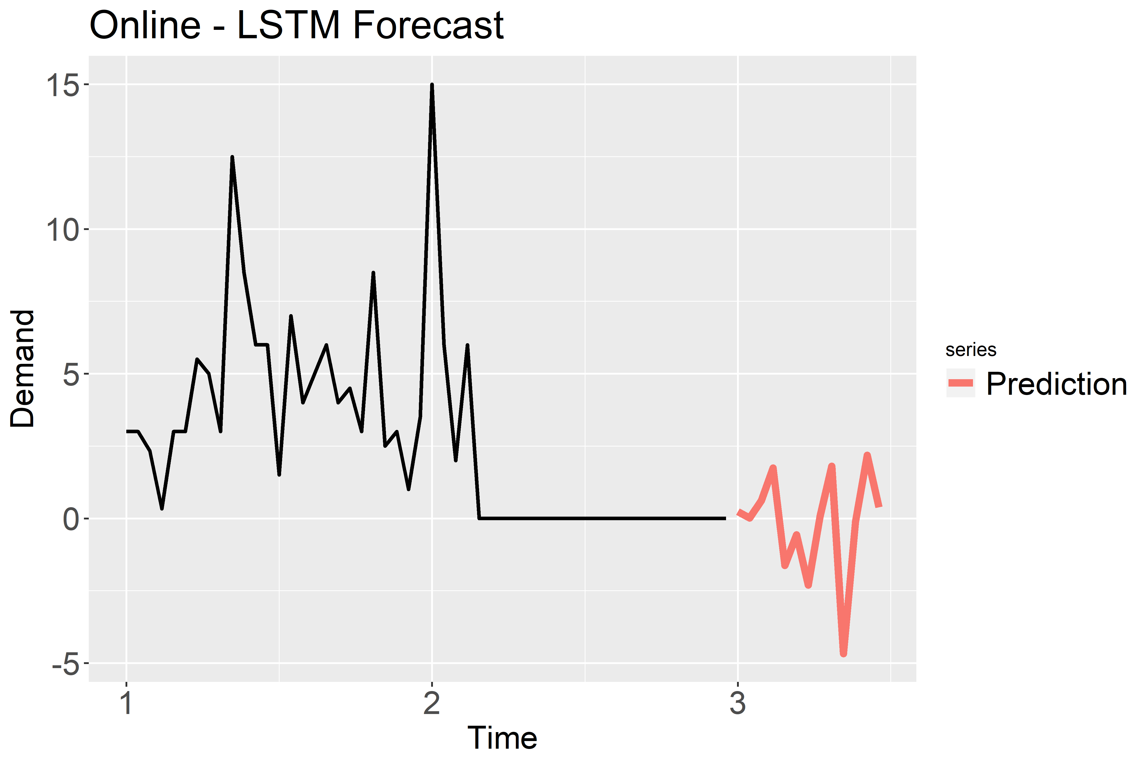
Online - STYLE207_BLUE_407D55
Legend
Time 1: January 2018
Time 2: January 2019
Time 3: January 2020

Slide 49
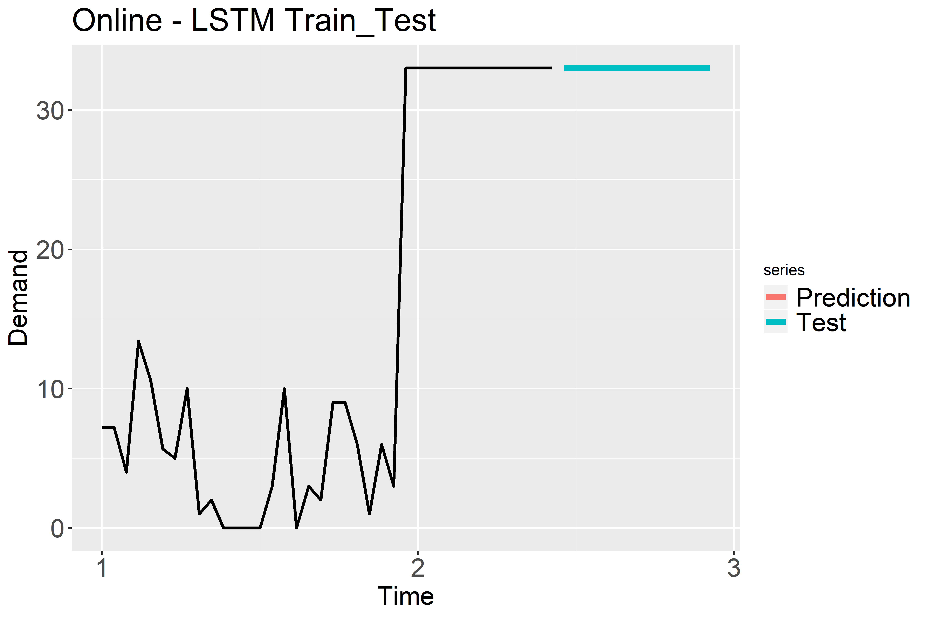
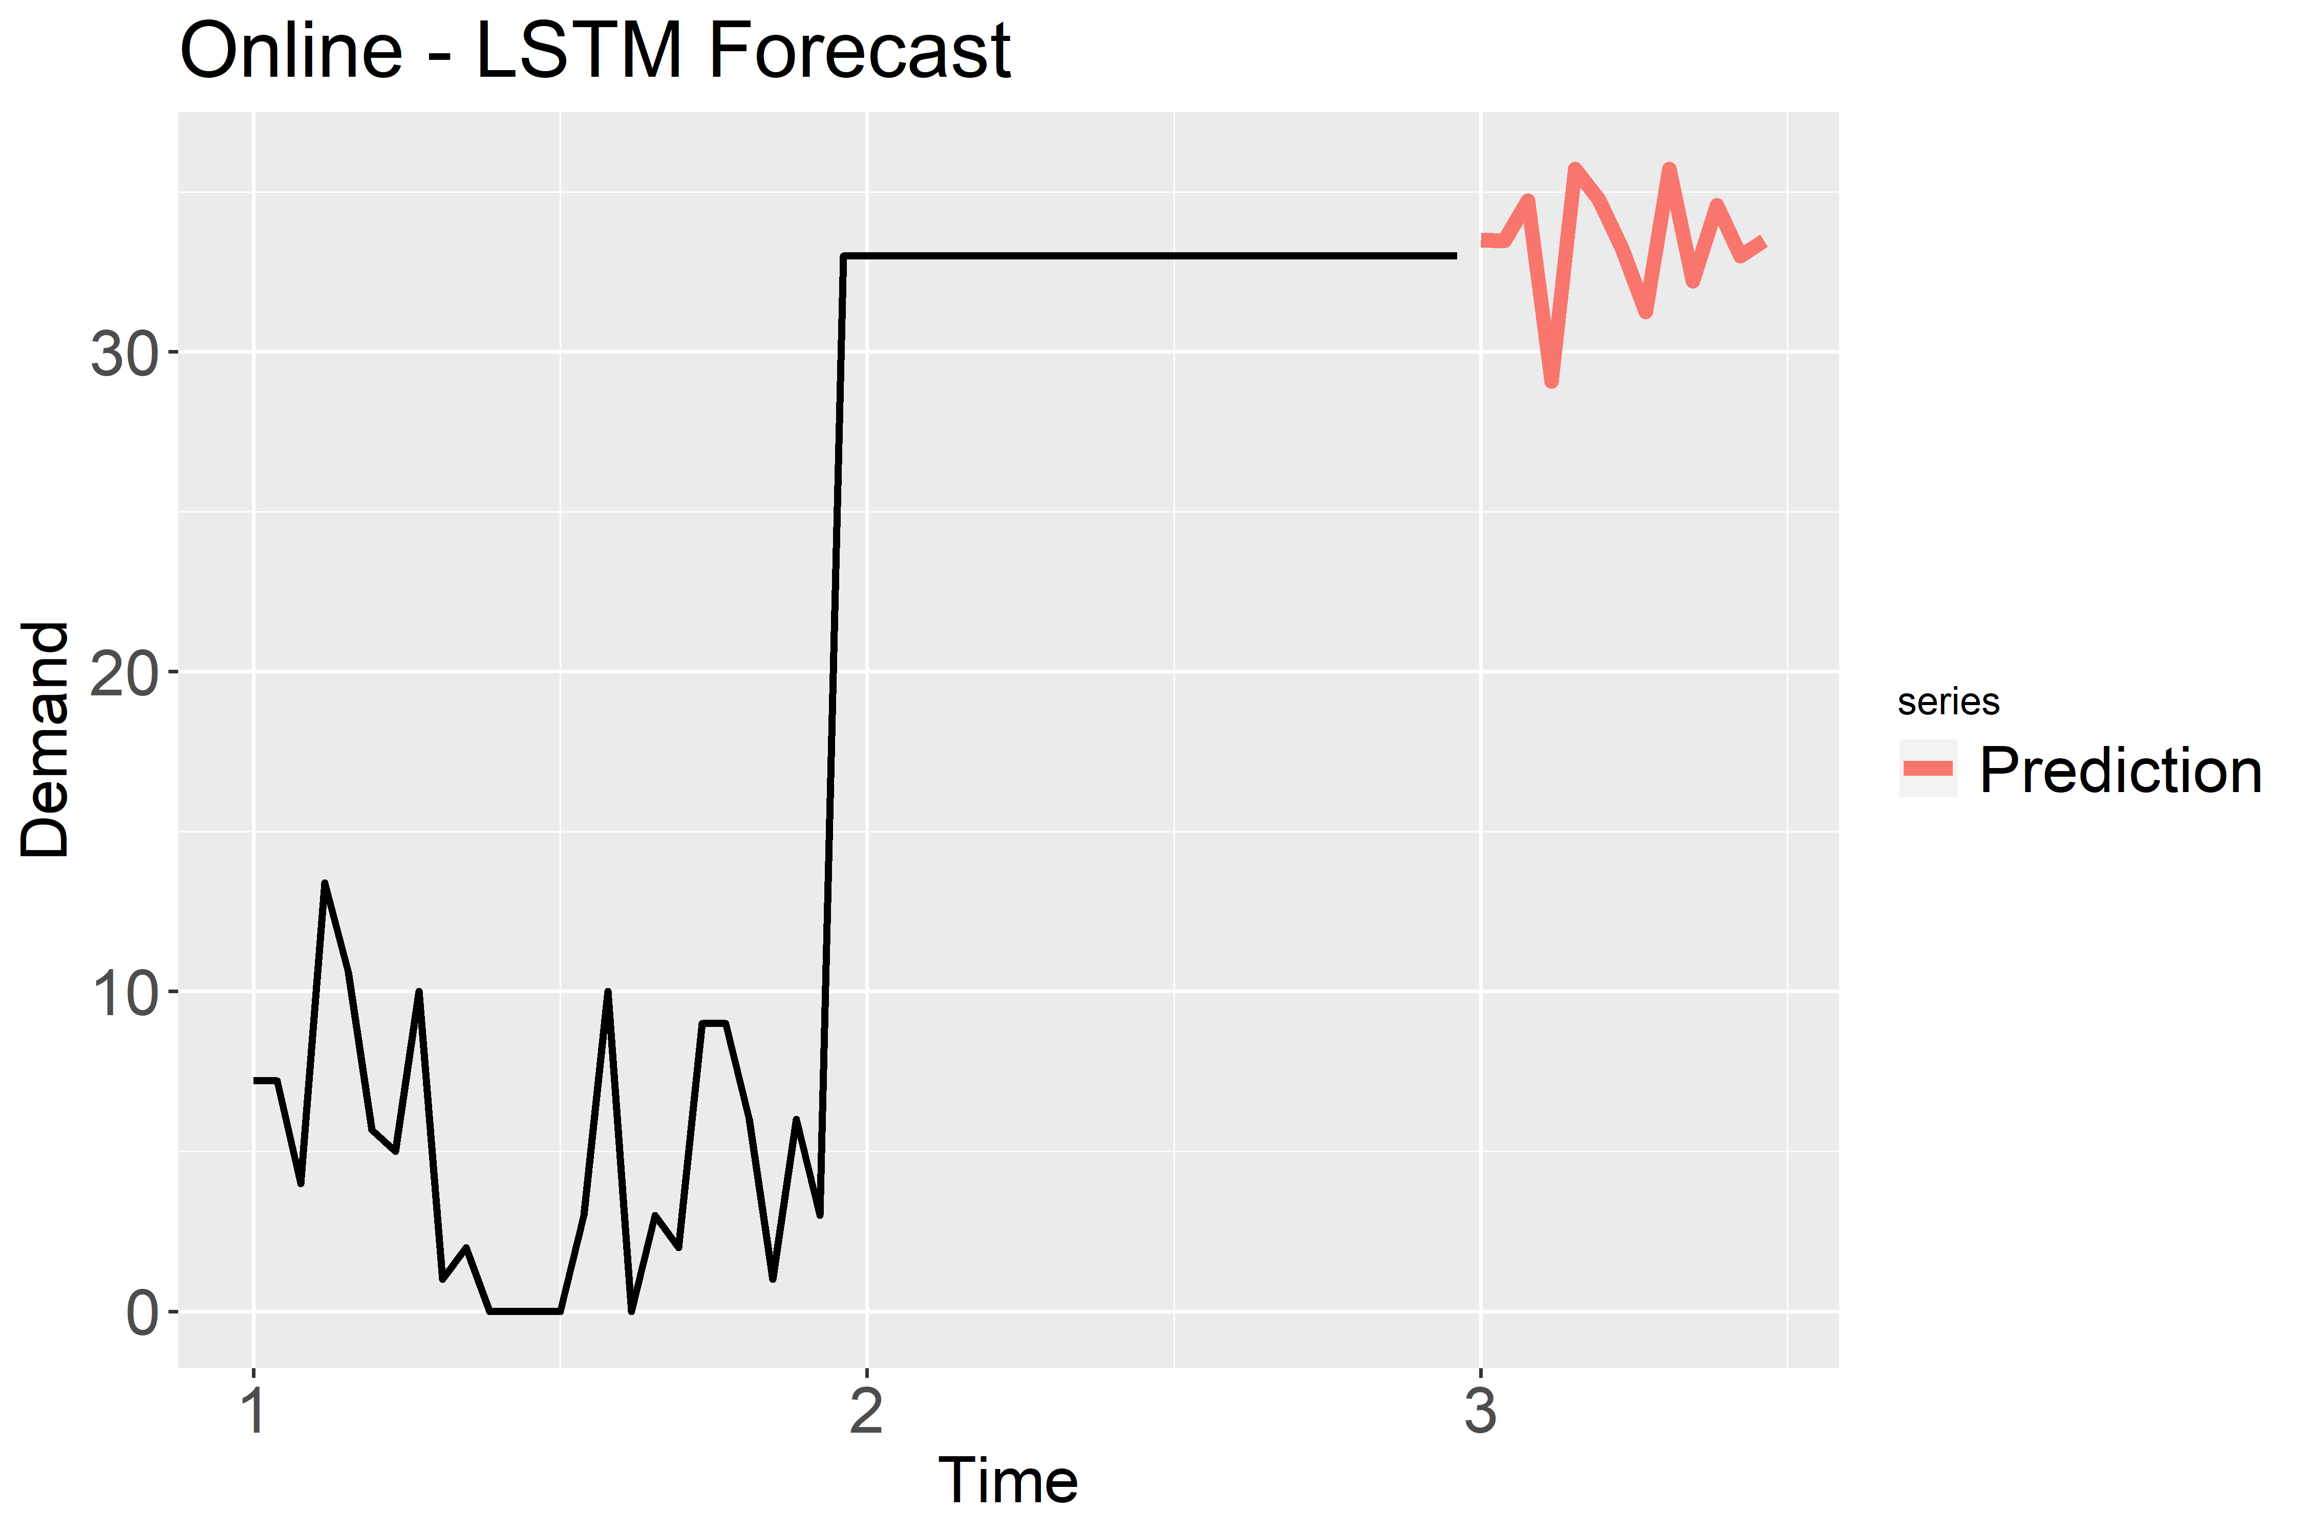
Online - STYLE357_GREY_------
Legend
Time 1: January 2018
Time 2: January 2019
Time 3: January 2020

Slide 50
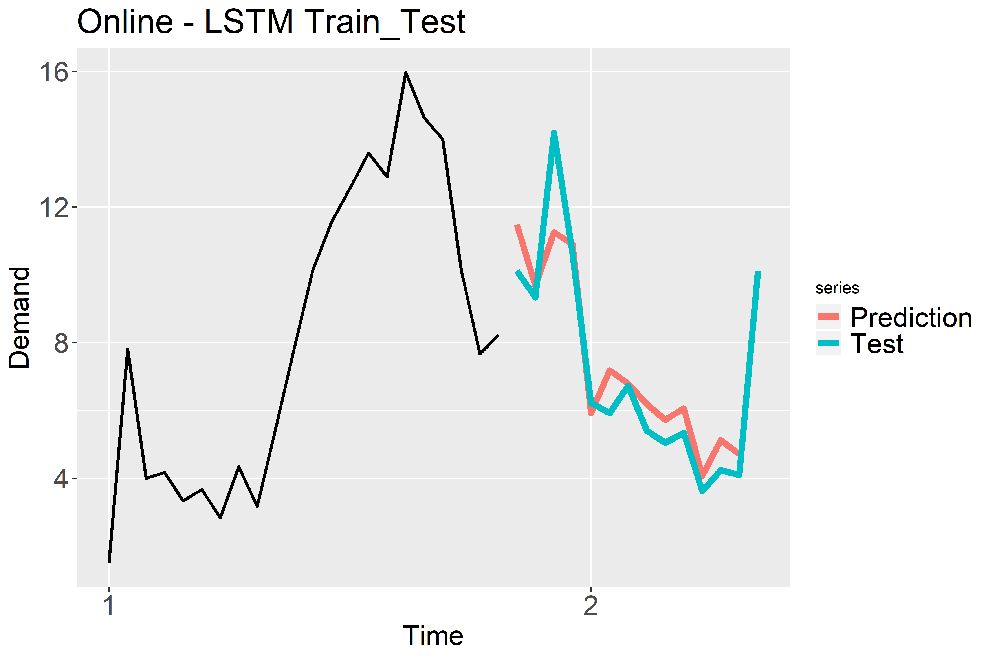
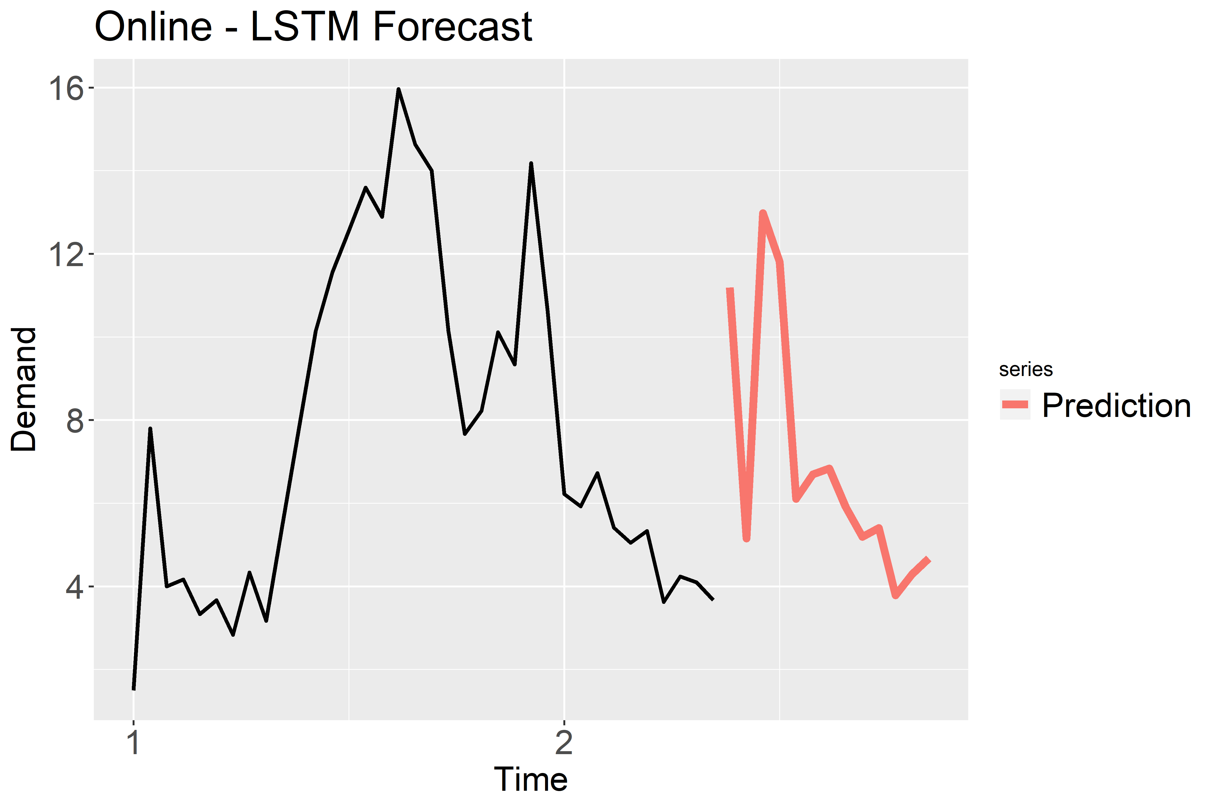
Online - STYLE111_RED_Y06145
Legend
Time 1: January 2018
Time 2: January 2019
Time 3: January 2020

Slide 51
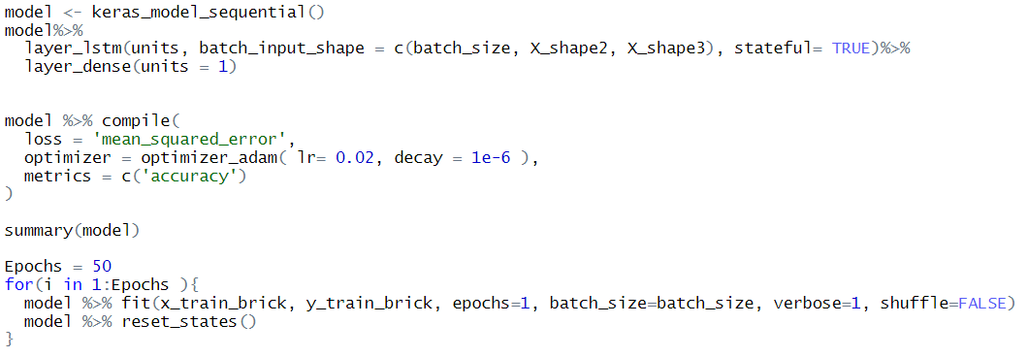
LSTM Model Creation

